Slide 1
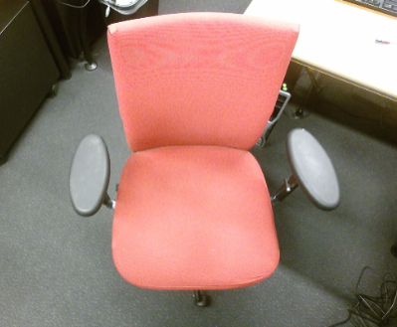
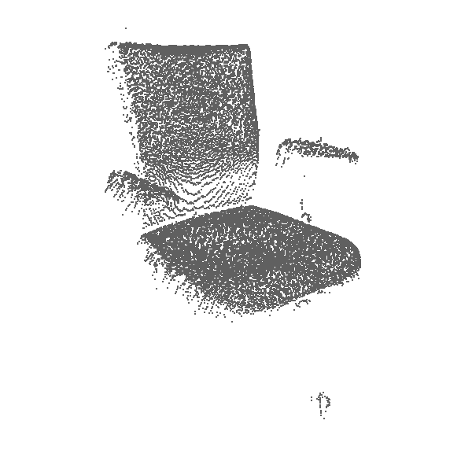
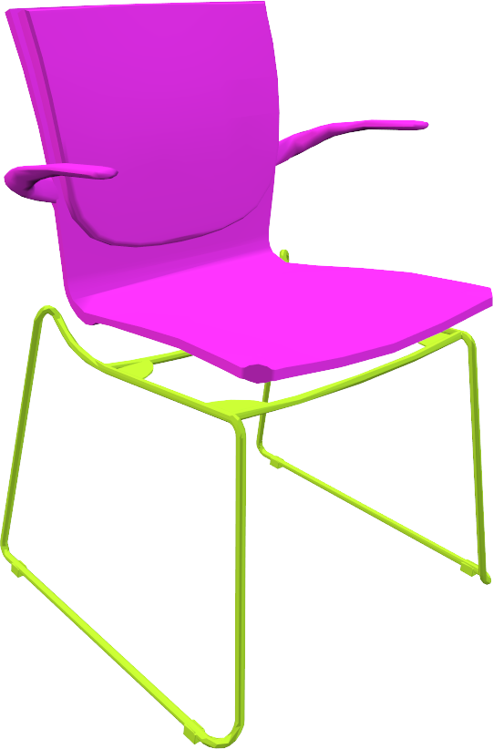
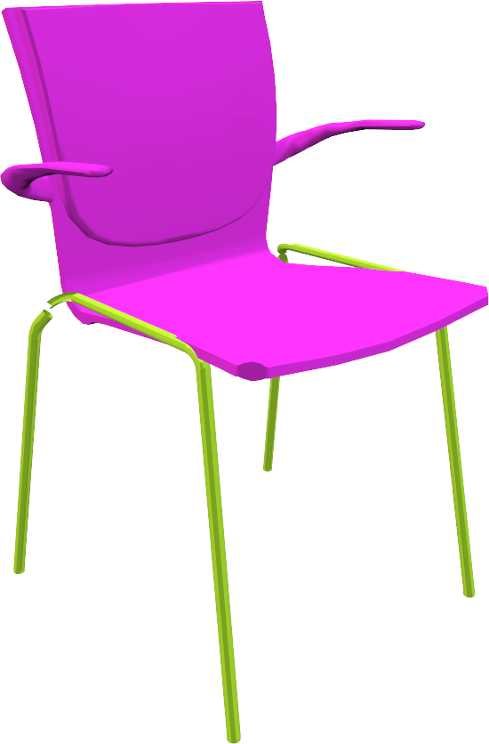
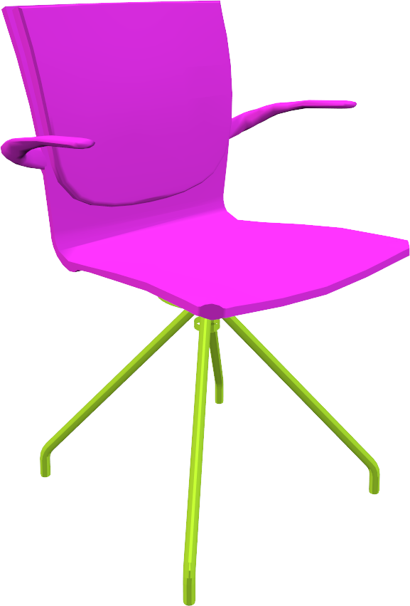
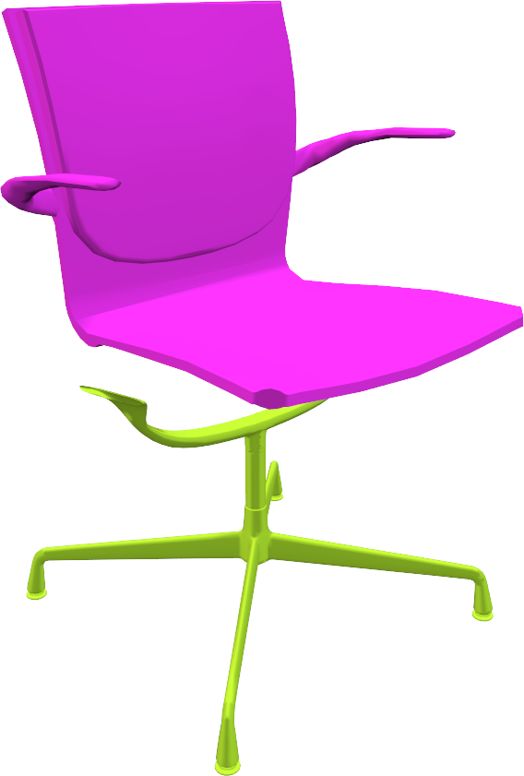
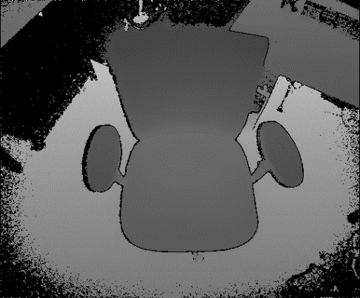
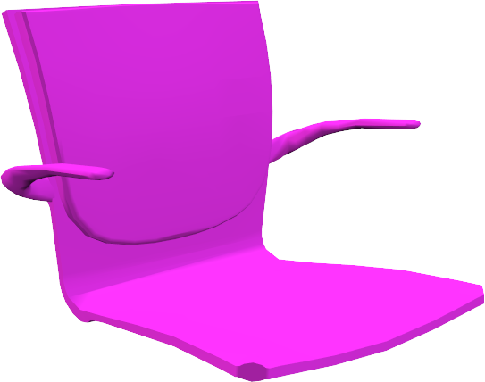
Learning Fuzzy Set Representations of Partial Shapes on Dual Embedding Spaces
Eurographics Symposium on Geometry Processing (SGP) 2018 Minhyuk Sung¹, Anastasia Dubrovina¹, Vladimir G. Kim², and Leonidas Guibas¹ ¹Stanford University ²Adobe Research

Slide 2
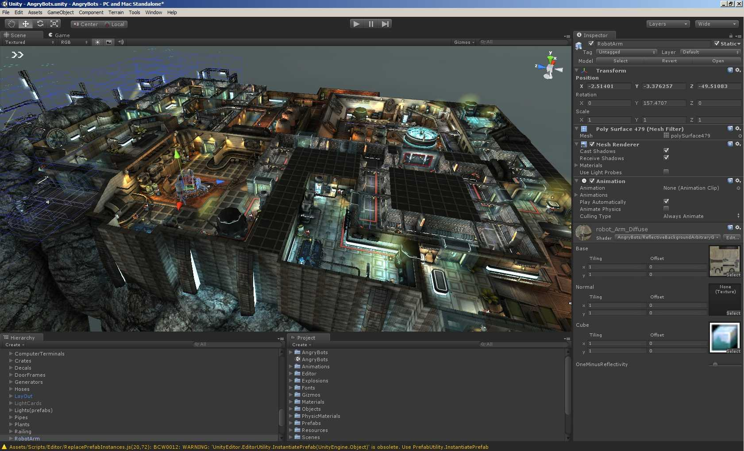
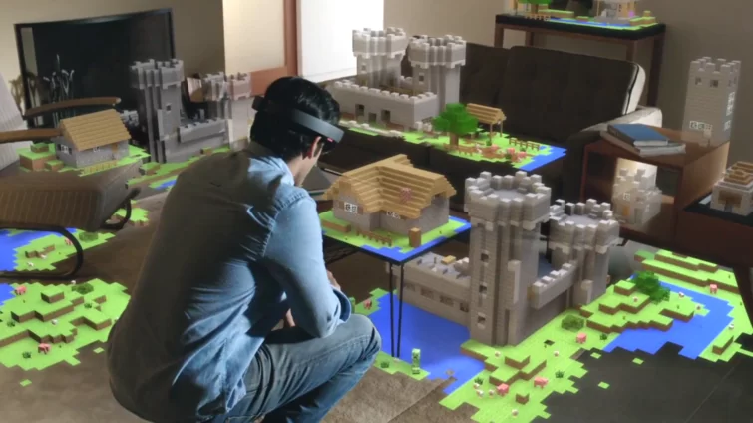
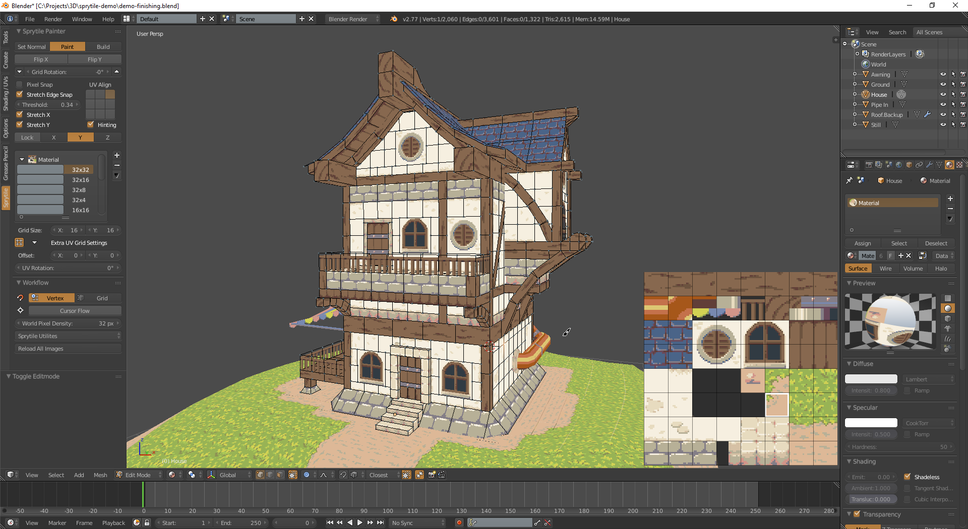
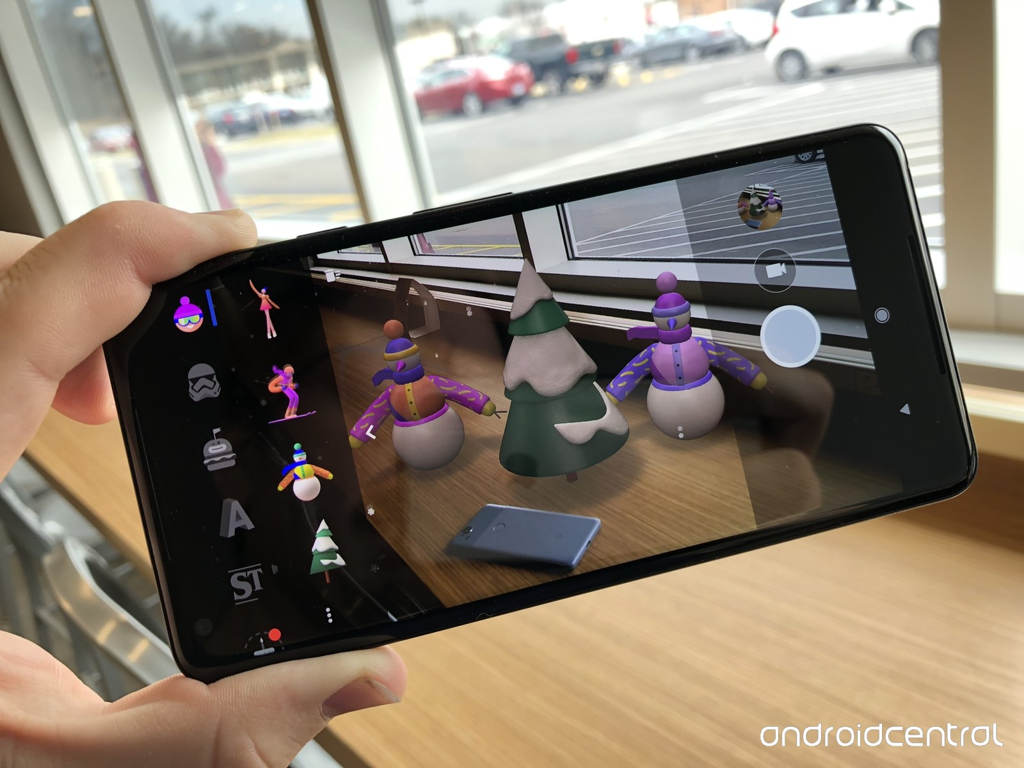
3D Applications Around Us
Unity3D
Oculus VR
MS HoloLens
Blender
Google AR Stickers
Apple ARKit
Notes:
Previously, 3D applications were something only experts can create.
[click]
But now there are many tools people can easily use for creating 3D games and animations.
[click]
And also, many new devices and sensors in mobile phones helping to create AR/VR applications.
So now we can see many 3D applications created by non-experts.
And this trend also brings the needs of new 3D modeling tools that can help us to make 3D models very easily and quickly.

Slide 3
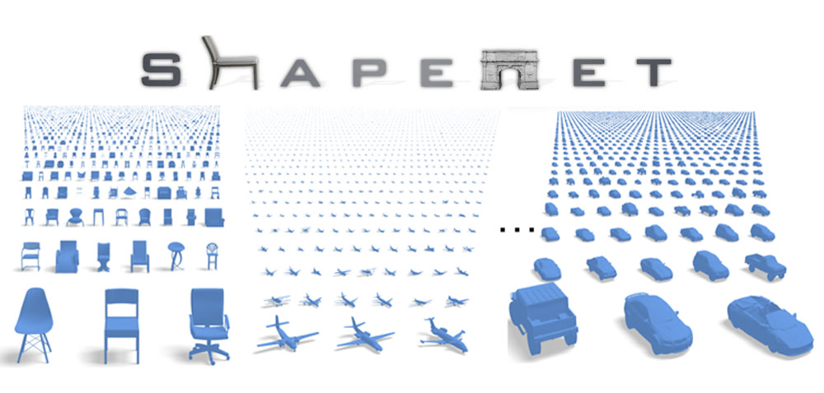
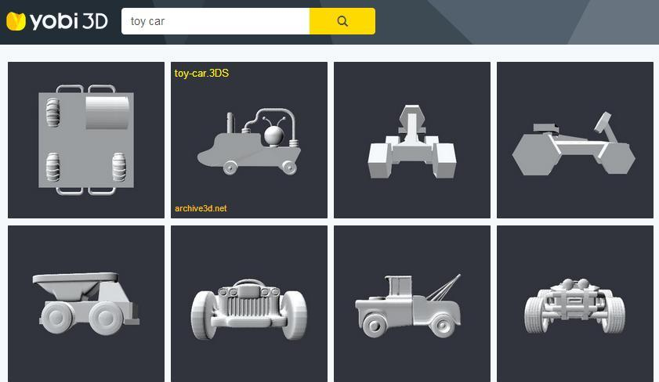
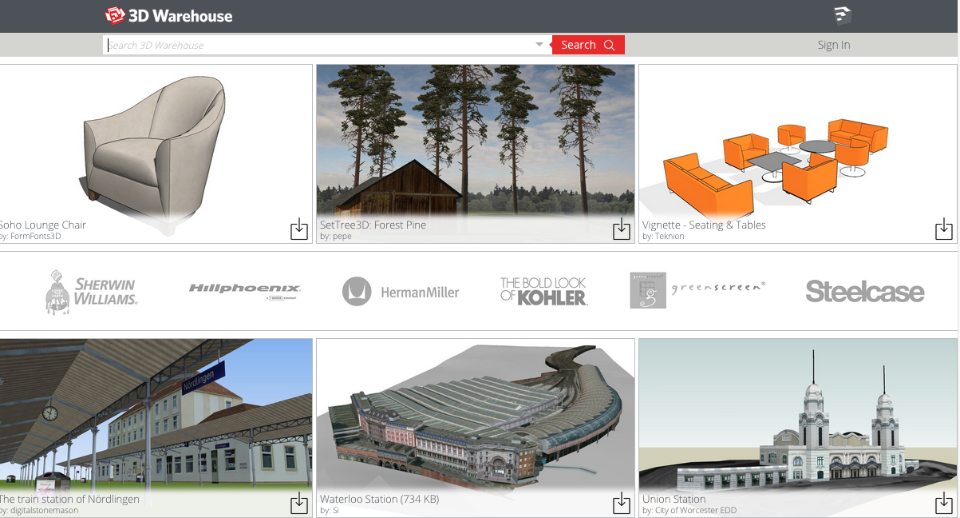
Large-scale Repositories
Notes:
Now we can also see online 3D repositories in a large scale, containing many 3D CAD models created by professional designers.
So instead of creating 3D objects yourself, you can consider to find some 3D models in these repositories.

Slide 4
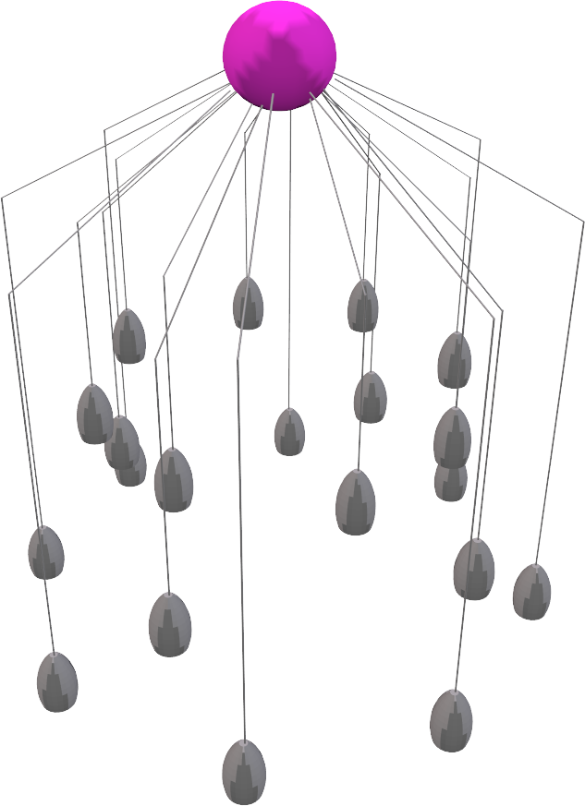
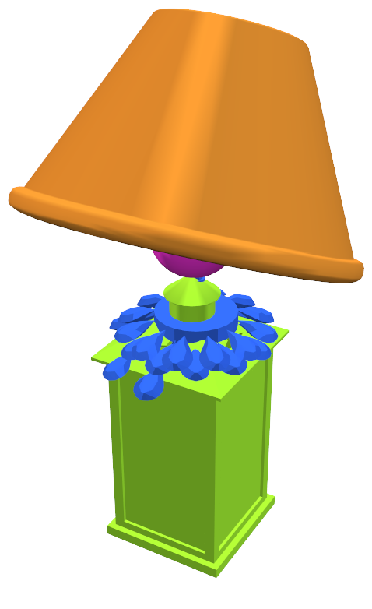
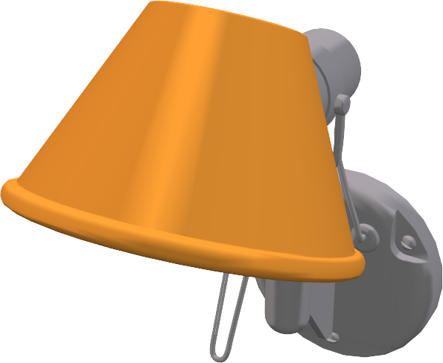
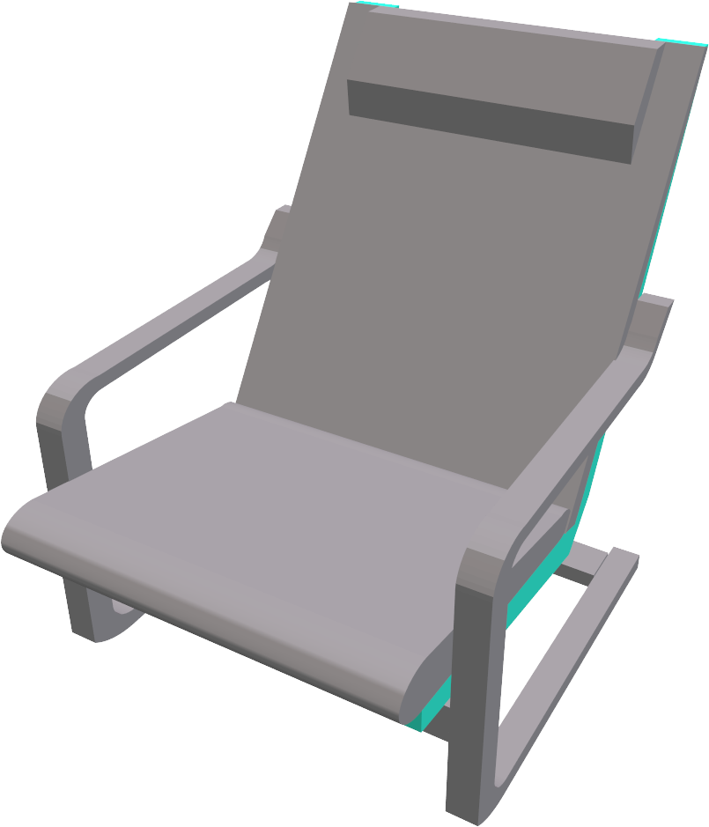
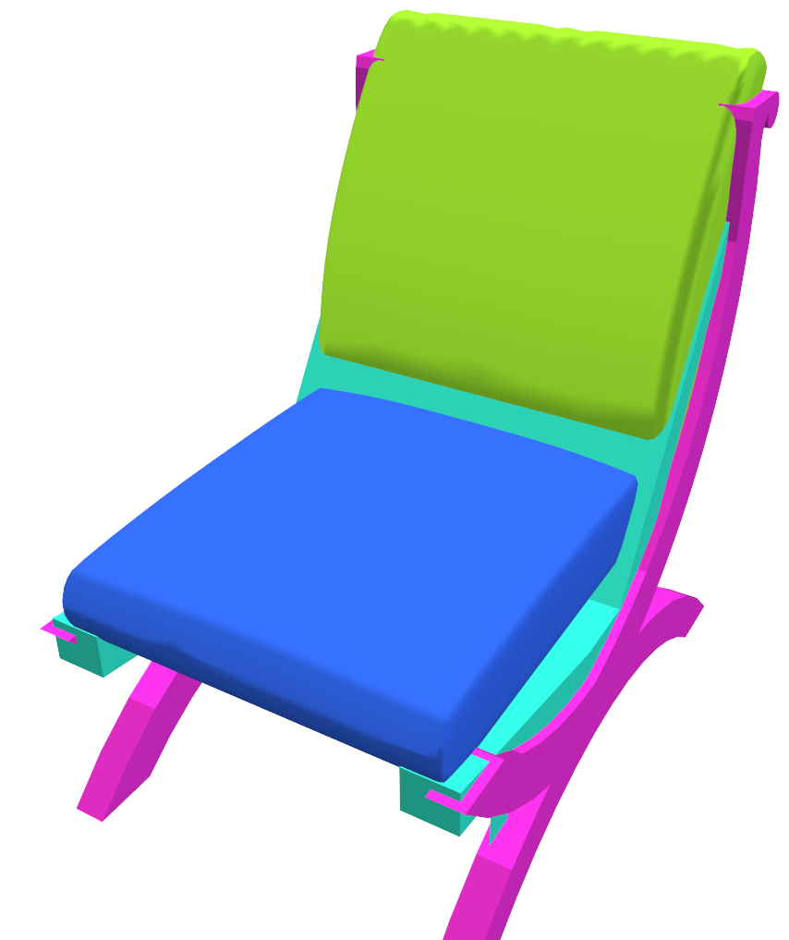
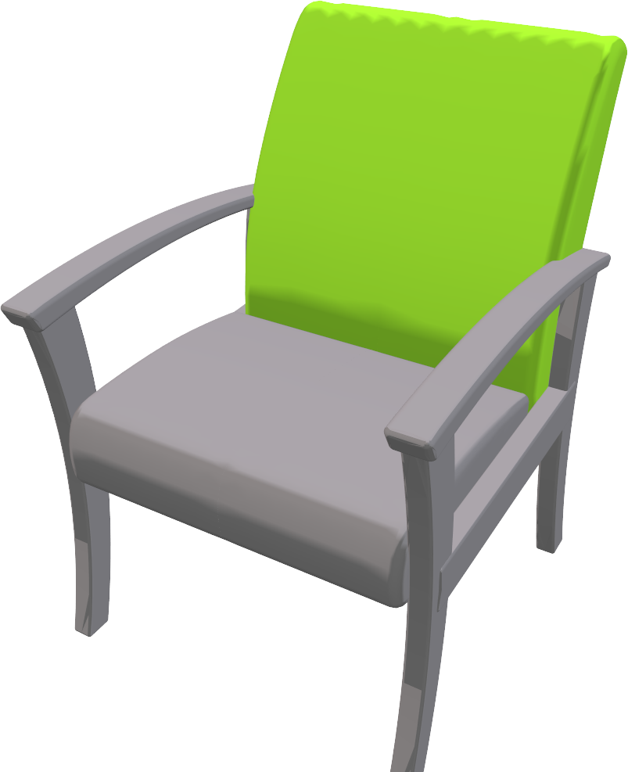
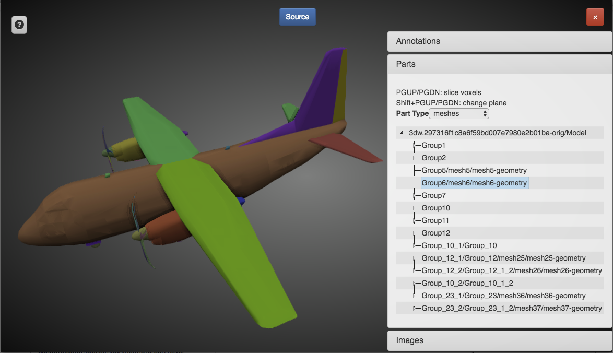
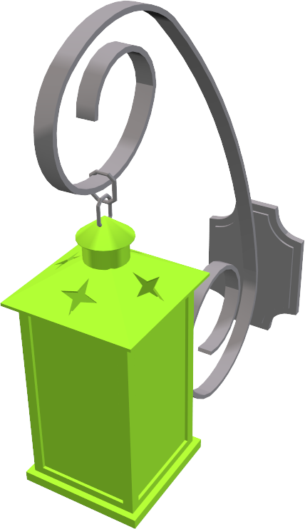
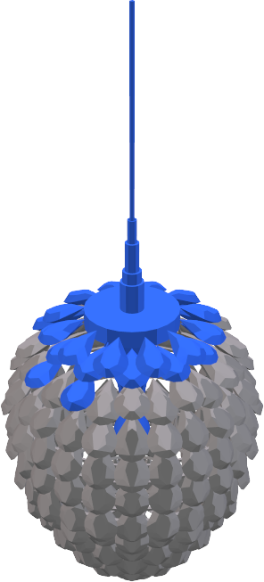
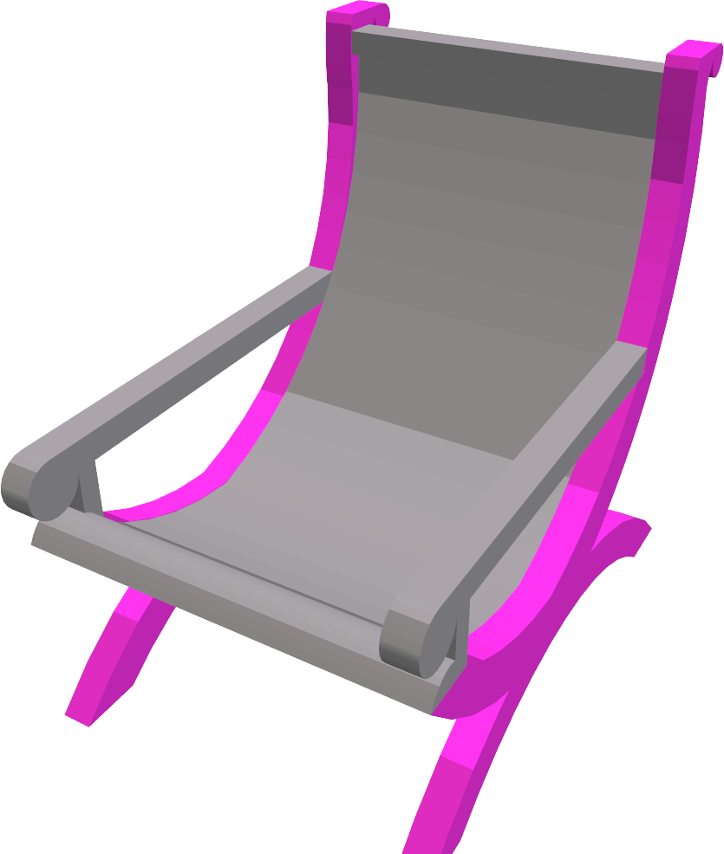
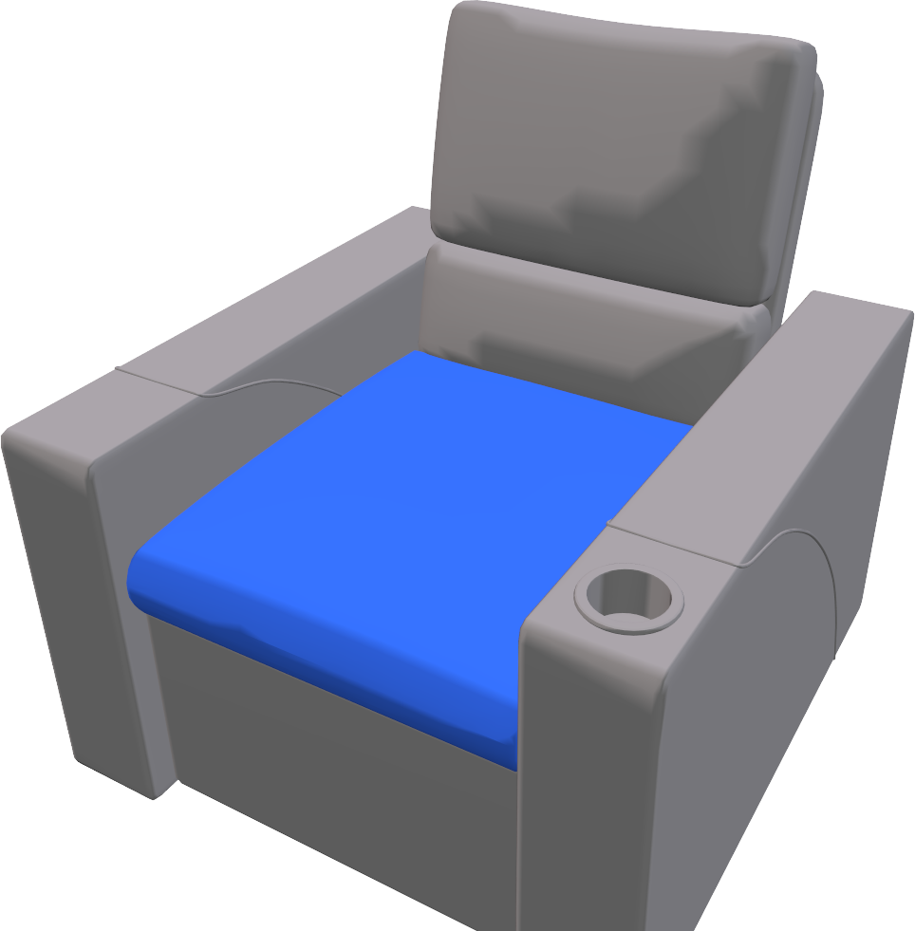
Component-based Modeling
Bring components from different objects and create a new object.
[ShapeNet]
[Sung et al., 2017]
Notes:
But still, it can be difficult to find the exact shape you want, and also editing these models can be challenging when you don’t have any expertise for that.
So here we propose something between creating objects from scratch and using existing models.
What people previously observed is that
[click]
most 3D CAD models are represented by a set of components disconnected to each other.
[click]
So when we bring these components from different shapes and assemble them, we can generate a new shape that does not exist in the database.
And also the assembly of components can be done very quickly with just few interactions.

Slide 5
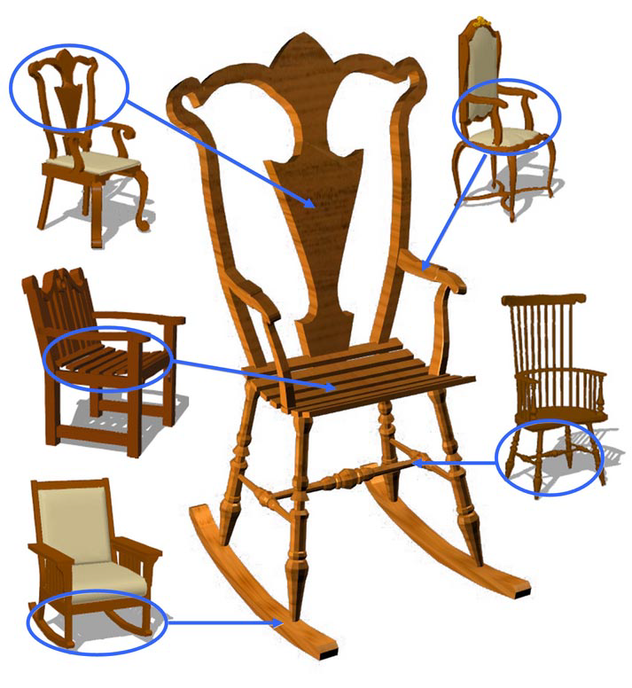
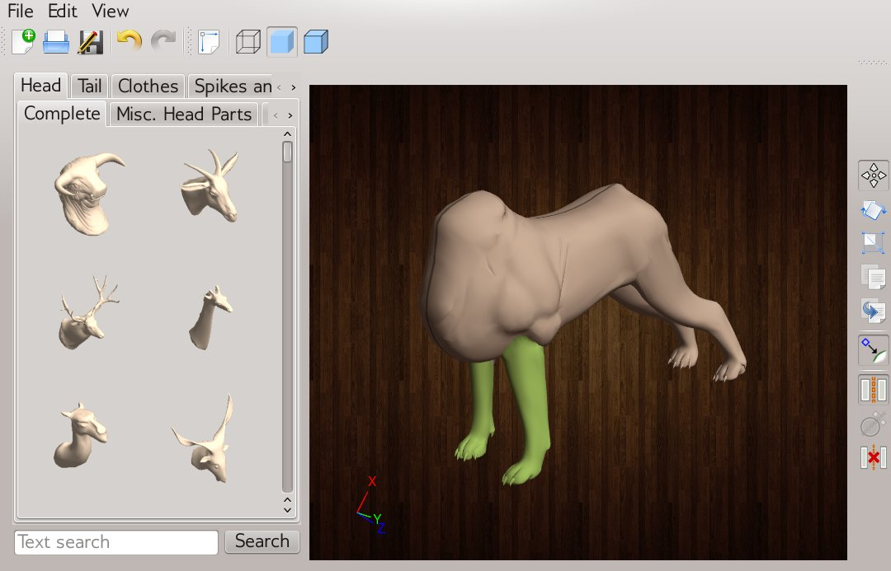
Component-based Modeling
[Chaudhuri et al., 2011]
[Funkhouser et al., 2004]
[Kalogerakis et al., 2012]
Notes:
This idea of component-based modeling was actually introduced a long time ago, and people have proposed various frameworks so far.

Slide 6
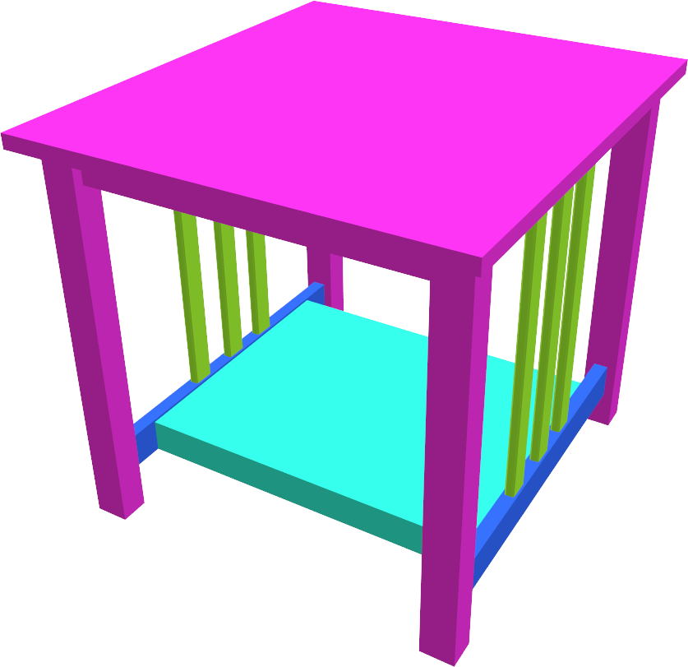
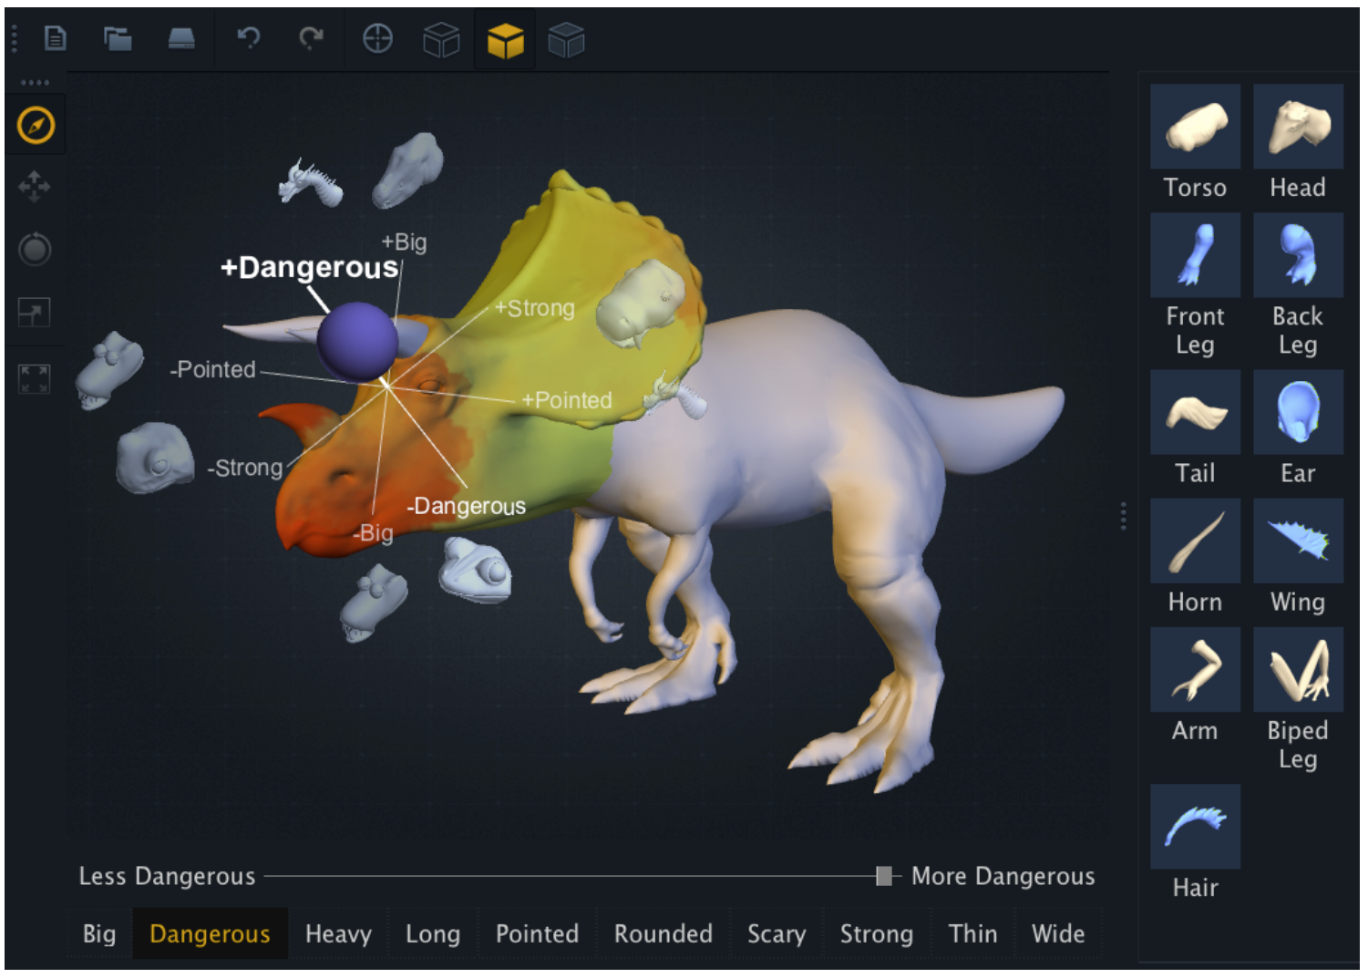
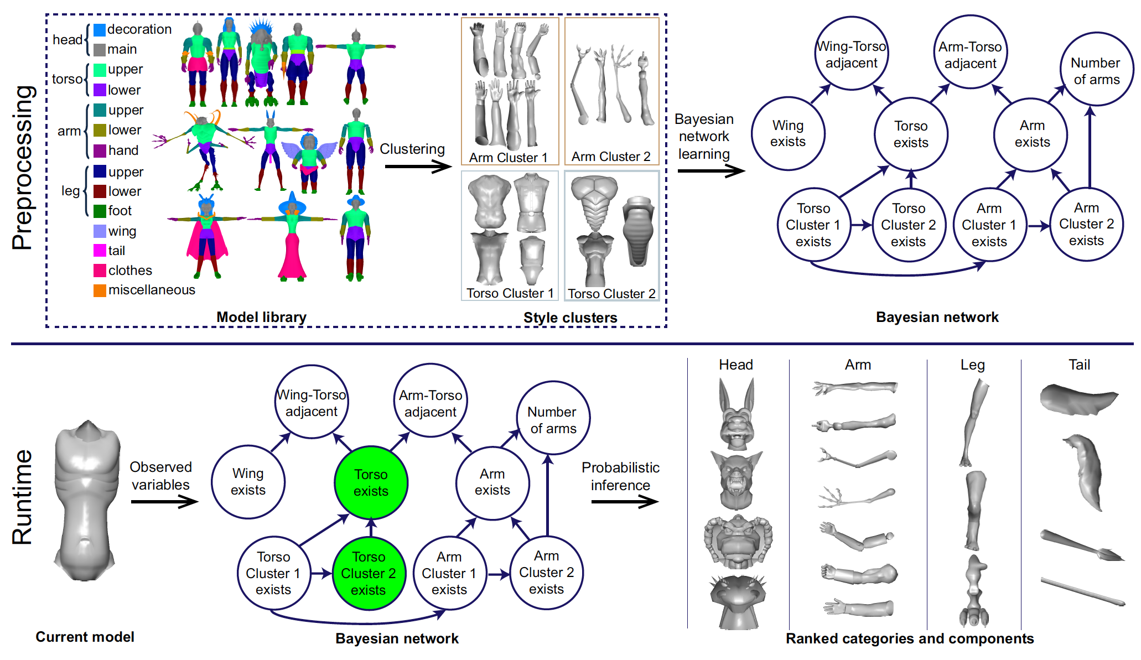
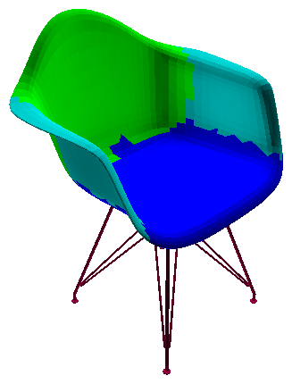
Challenge
Heavy burden of annotations.
Hard to define proper names and boundaries of parts.
Name?
[Chaudhuri et al., 2013]
Boundary?
[Chaudhuri et al., 2011]
Notes:
But the limitation of most of the previous work is that they rely on the labels of components indicating their functionalities and styles.
And the labeling is a very time-consuming task especially when the database is large.
[click]
And also, as we see a larger diversity of shapes, it becomes more difficult to find proper names and proper boundaries of the parts.

Slide 7
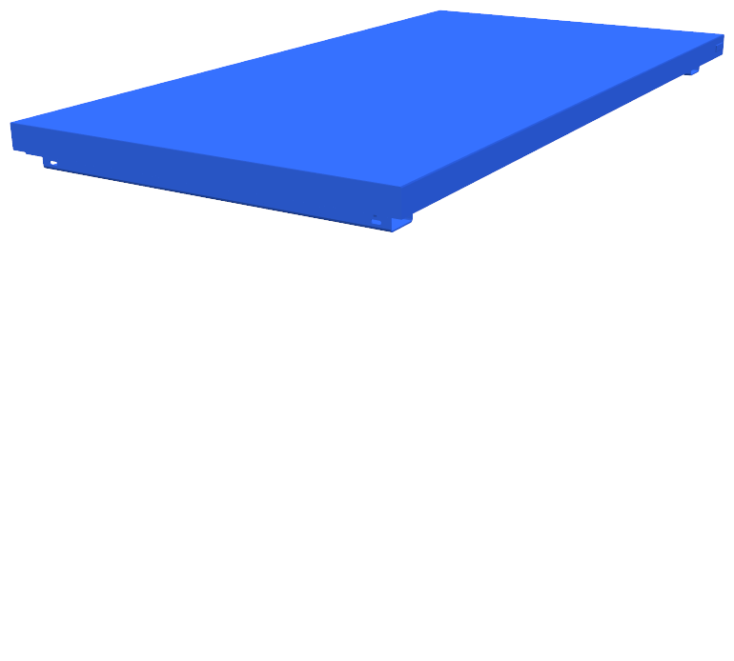
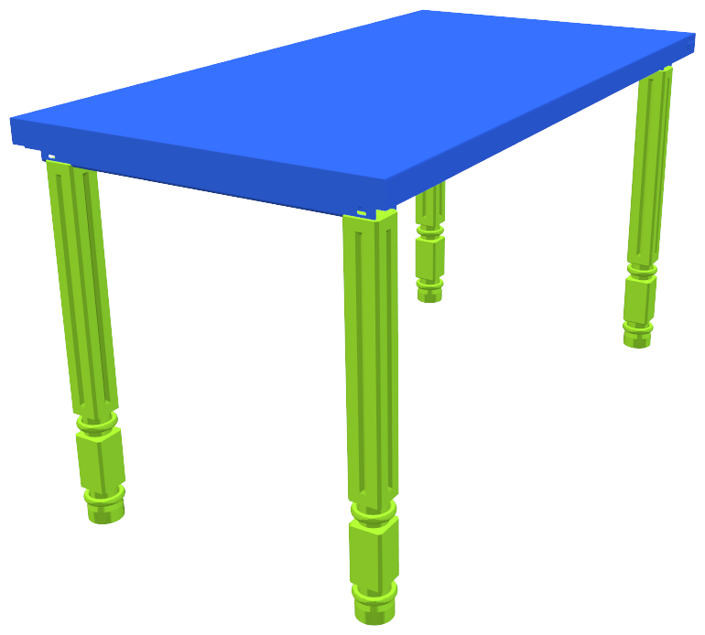
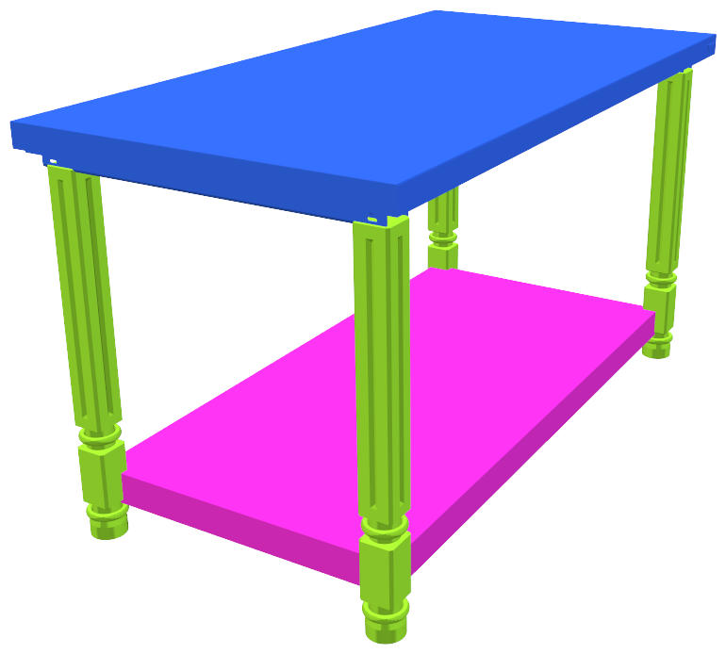
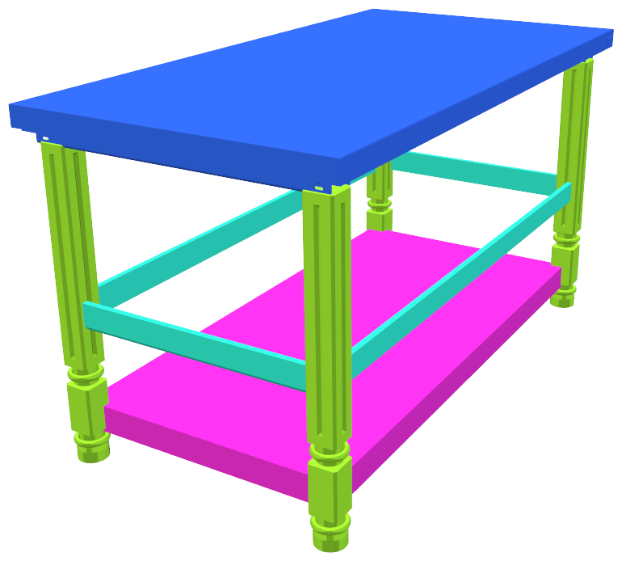
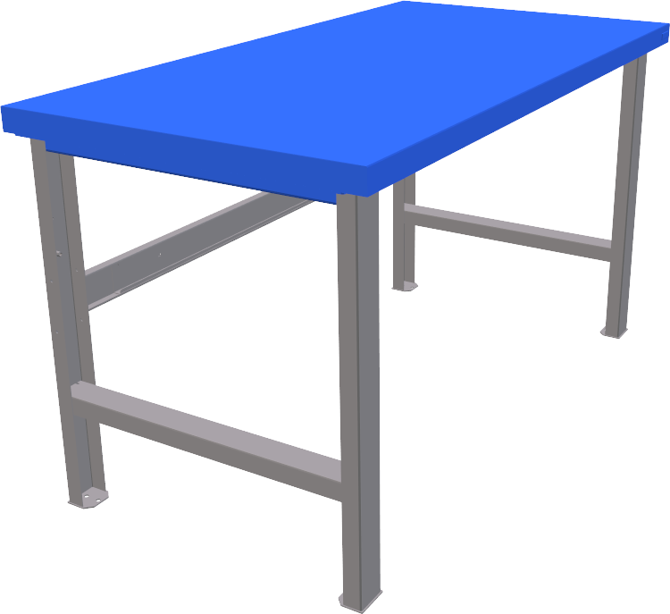
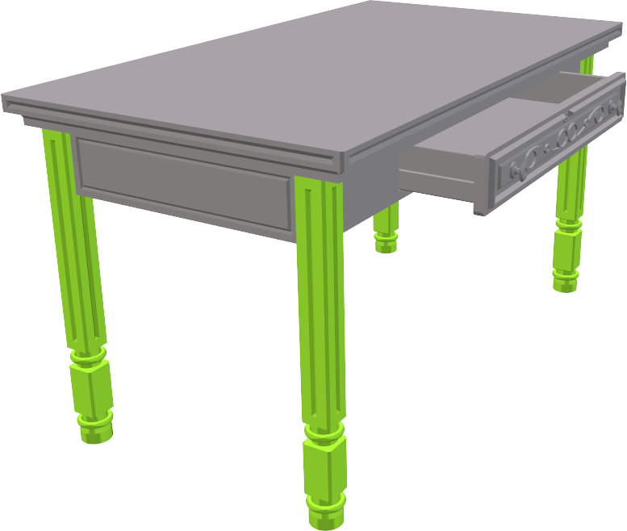
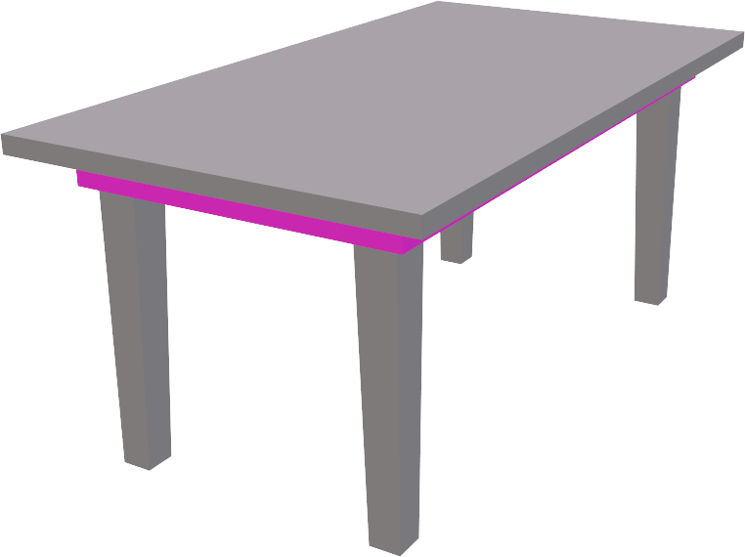
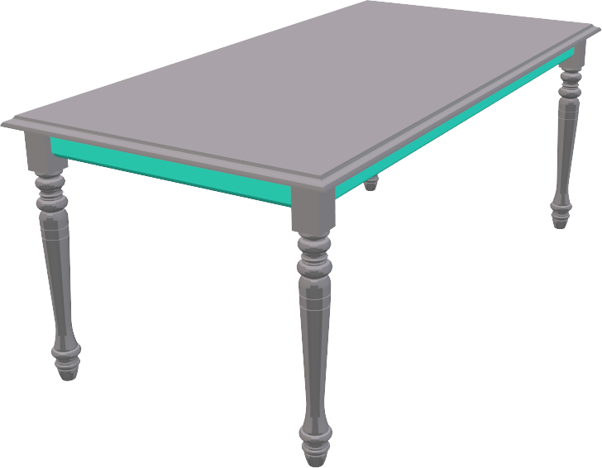
Previous Work
ComplementMe [Sung et al., 2017]
Assemble uncurated and unlabeled components.
Learn a relation from a partial shape to a single component.
Notes:
So in our previous work, we tried to learn the relation among components, using a neural network and the geometry information of components.
Specifically here, we trained a neural network to learn which single component can be added to the given partial shape.
And the system could iterate the assembly of components using the trained model.

Slide 8
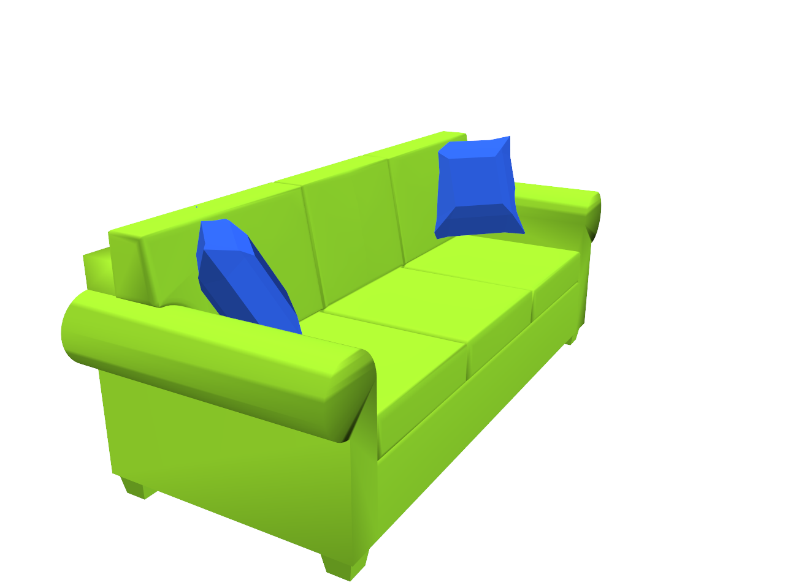
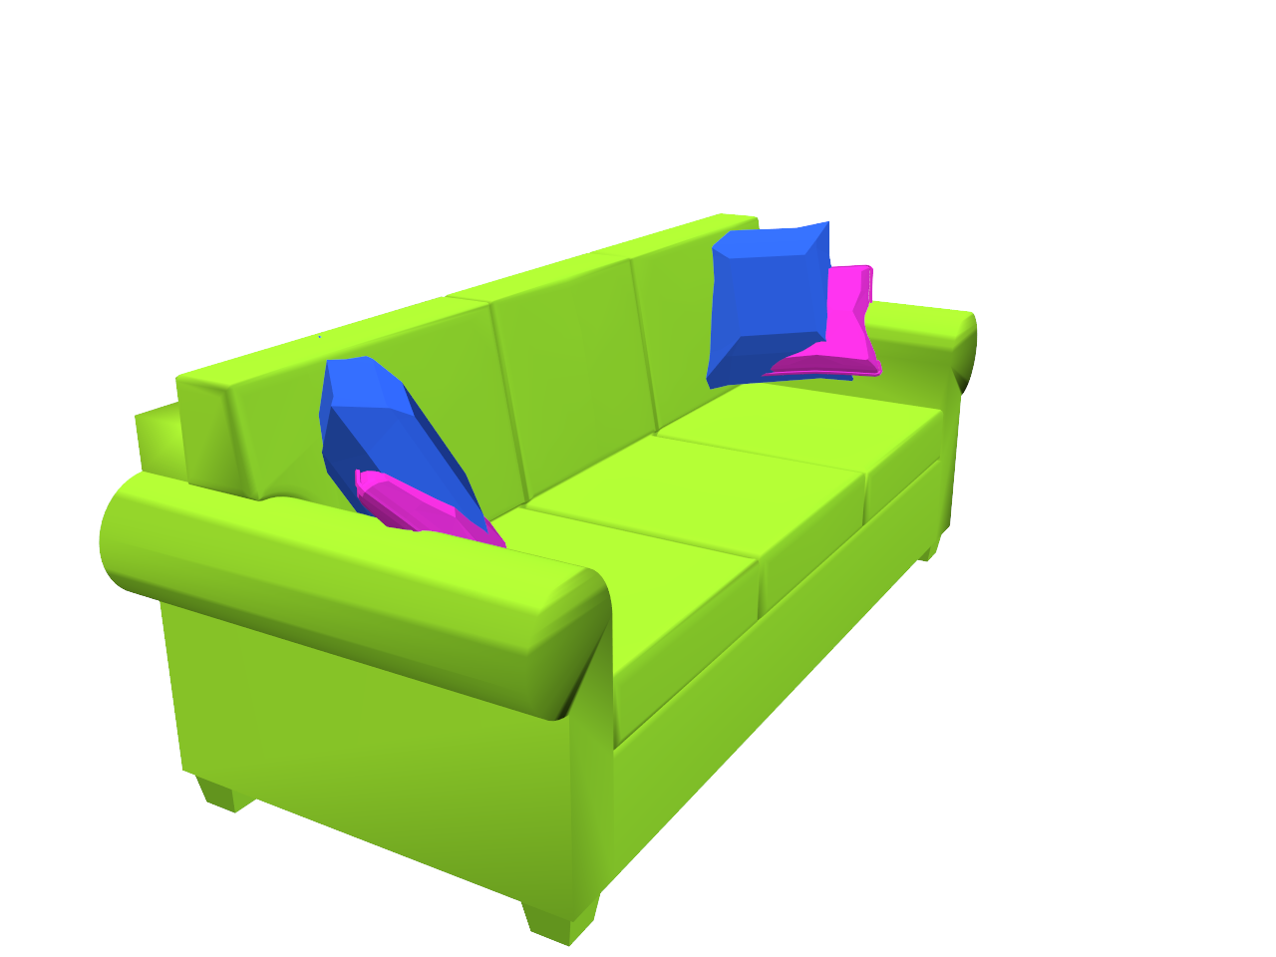
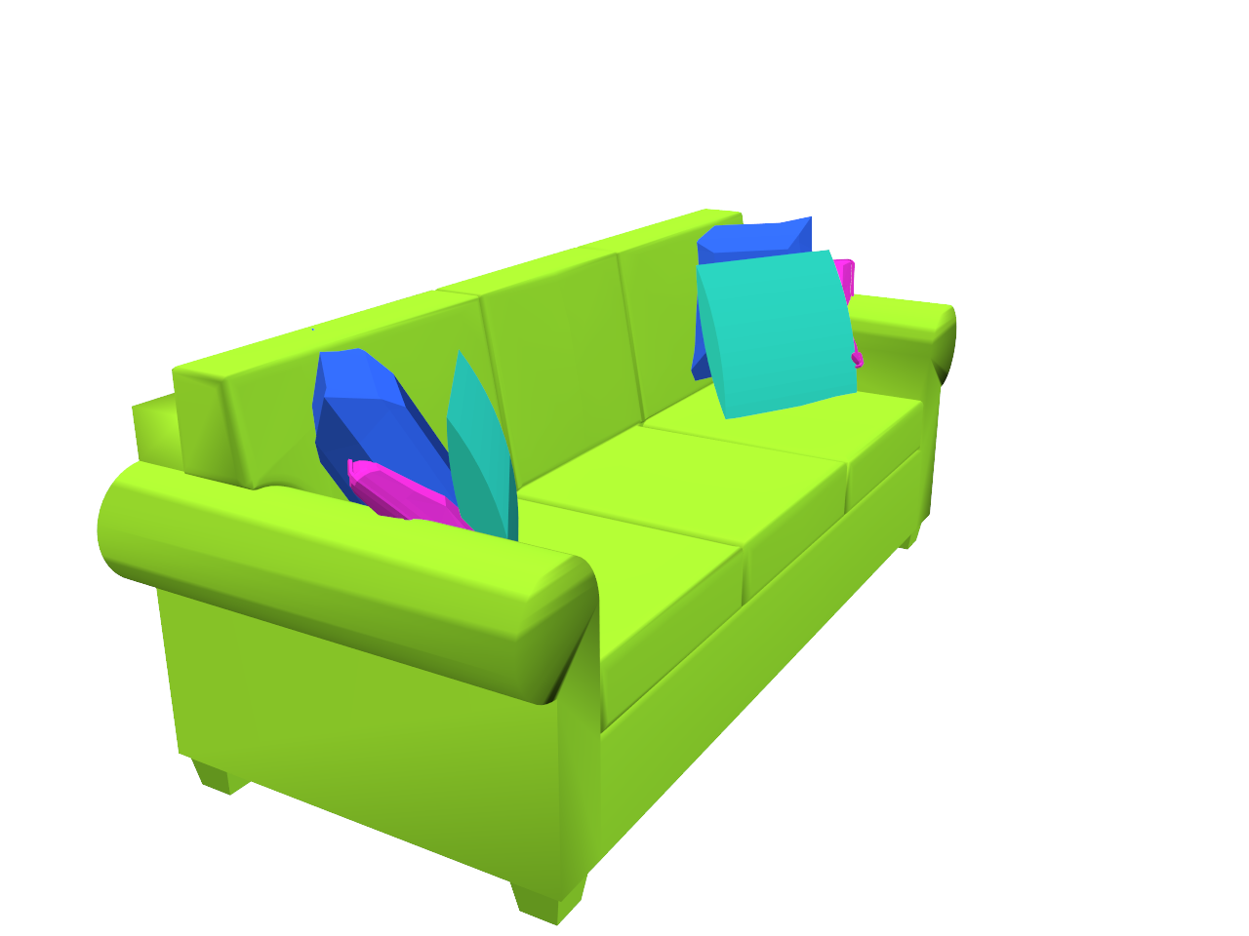
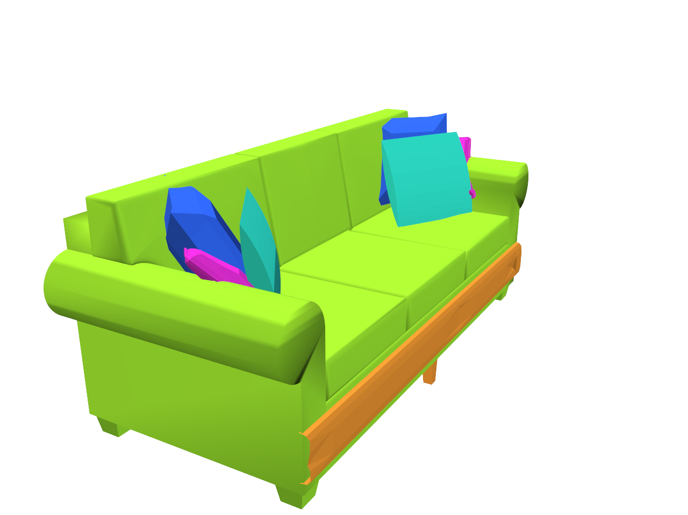
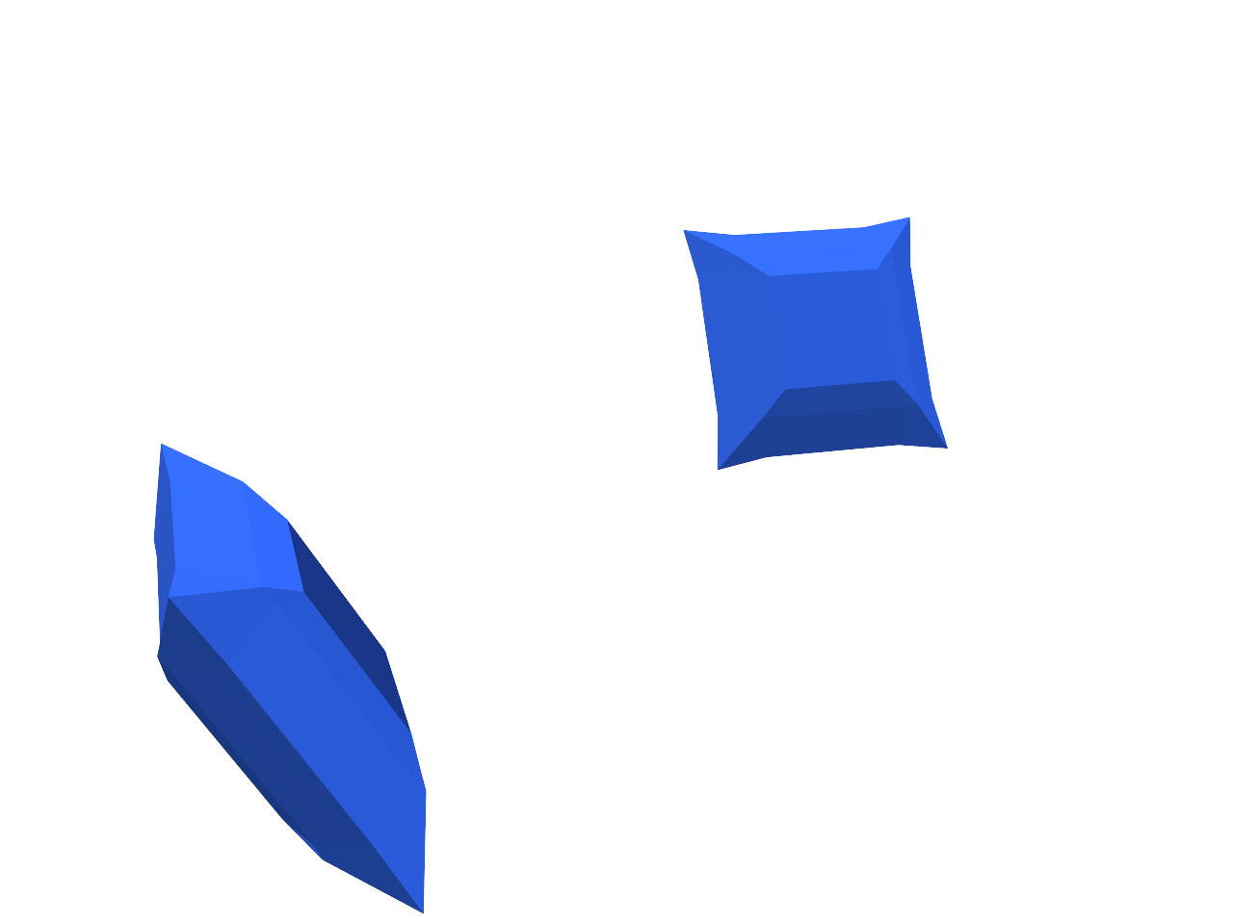
Previous Work
Limitations
Accumulating noise in iterations.
Missing notion of termination.
Already complete!
What happens if we keep going…?
Notes:
This framework works well in many cases, but it has certain limitations.
First, It requires multiple iterations to complete an object, so one single bad prediction in the iterations can lead to a bad output at the end.
Second, there is no notion of termination, so the system does not know whether the input really needs more components, or it needs to stop adding more components.

Slide 9
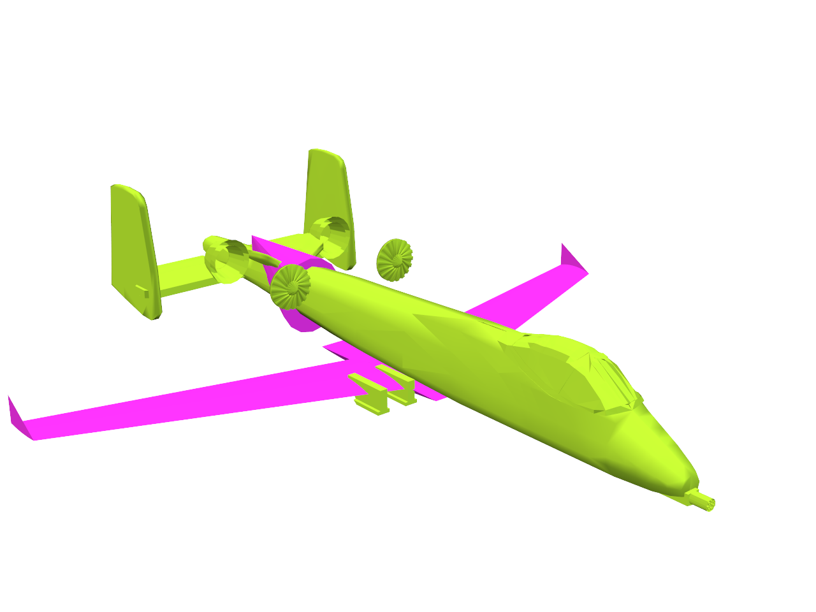
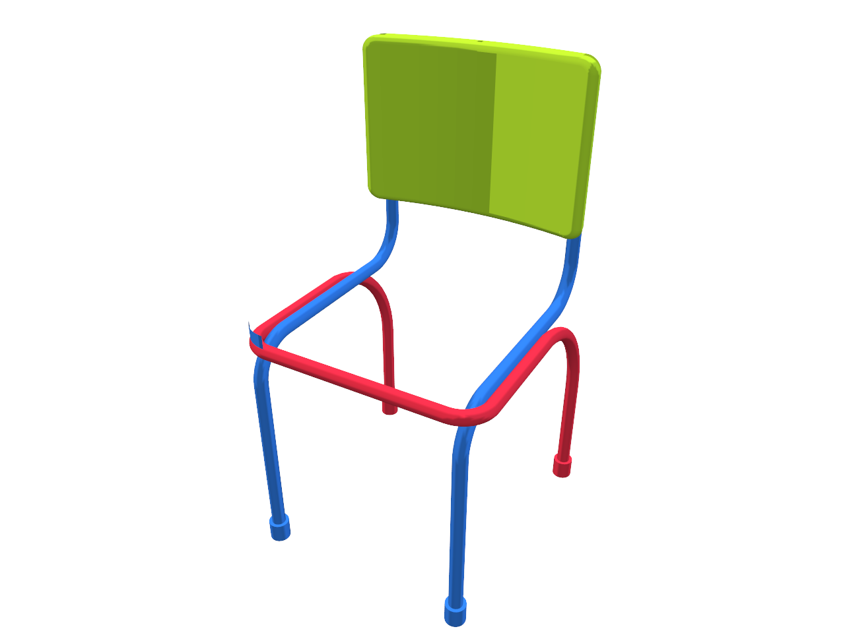
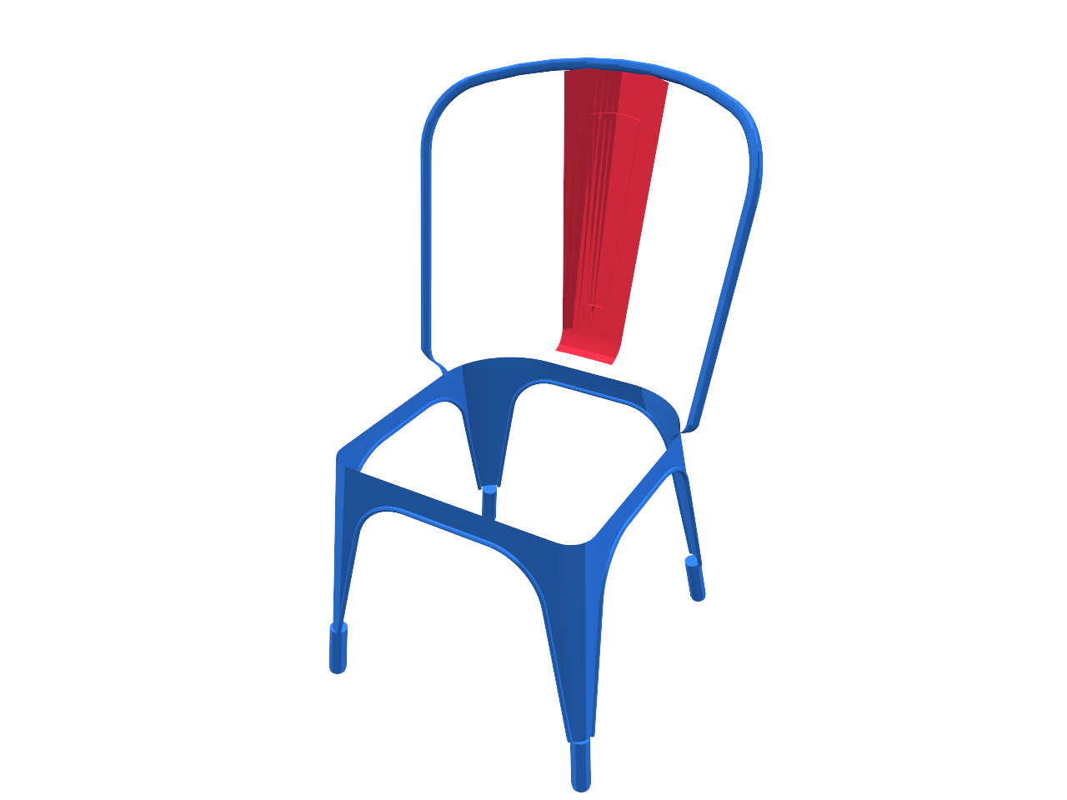
Relations Among Partial Shapes
Learn relations among partial shapes.
Can complete an object with a single retrieval.
Can discover group-to-group relations.
Interchangeable
Query
Retrieval
Notes:
To solve these issues, in this work, we propose a framework learning relations among partial shapes, not single components.
So here, both the input and the output are partial shapes, meaning sets of components.
So the system can find a whole complement of the given partial shape with a single retrieval.
Also it can discover more complex relations among all groups of components, and can enable more general analysis of component structures.

Slide 10
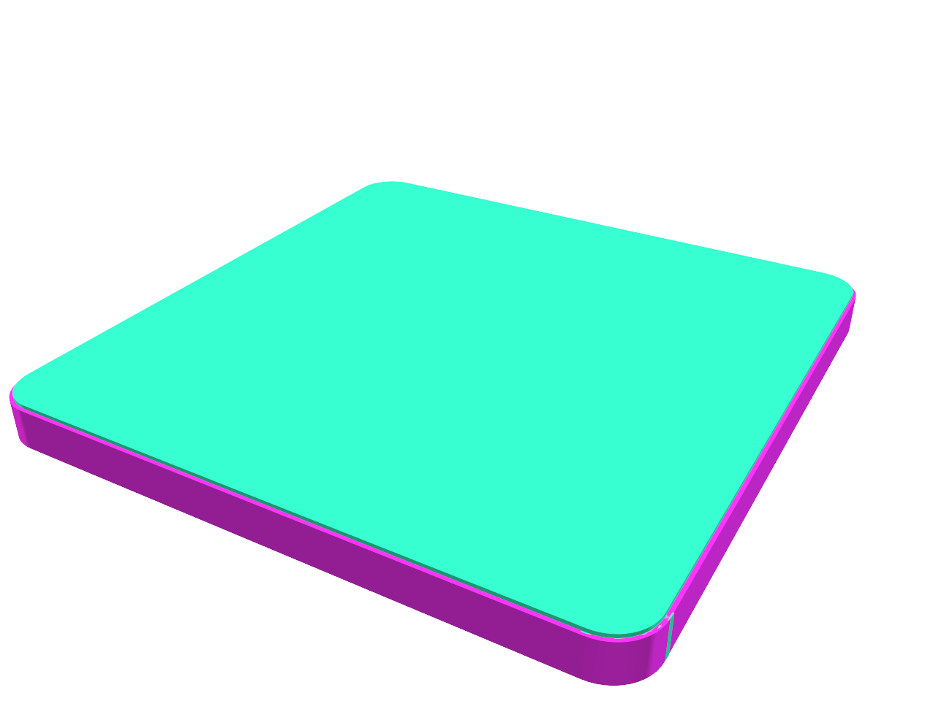
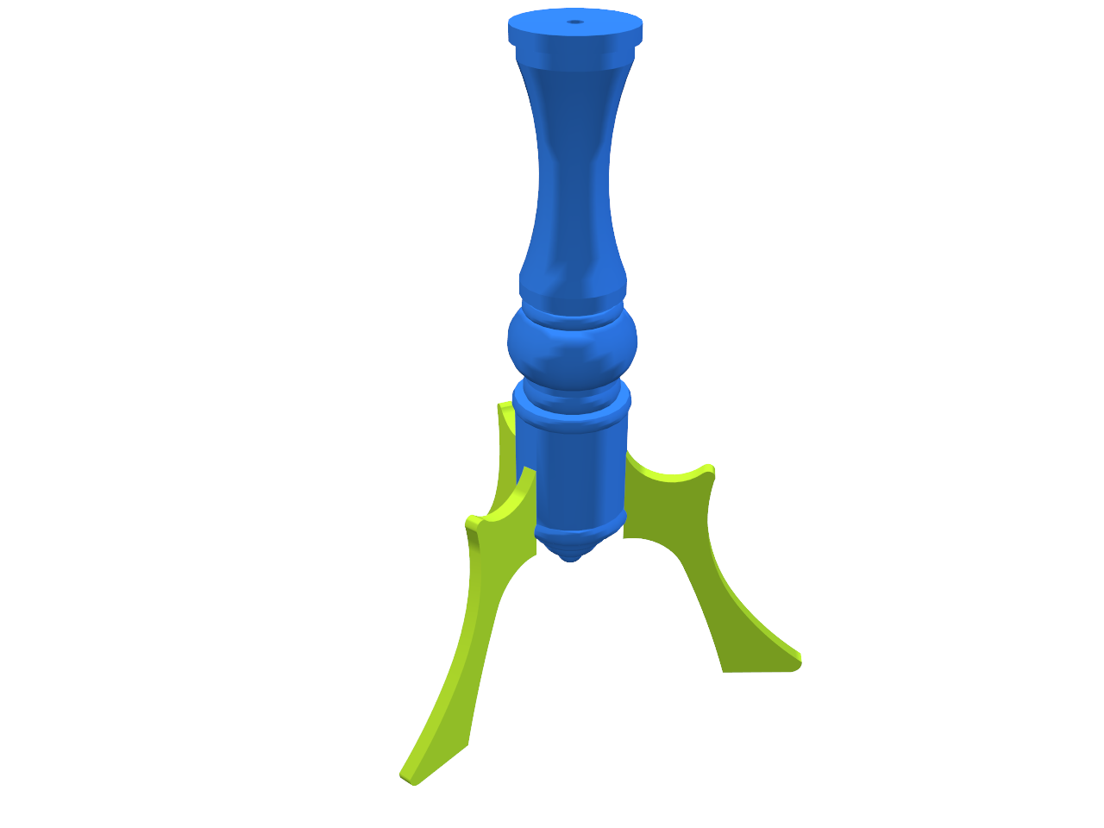
Relations Among Partial Shapes
Learn relations among partial shapes.
Complementarity
Interchangeability
Interchangeable
Complementary
Complementary
Interchangeable
Notes:
Specifically, we consider two types of relations:
[click]
complementarity and
[click]
interchangeability.

Slide 11
Relations Among Partial Shapes
Complementarity : Two partial shapes can be combined into a complete and plausible object.
Complementary
Complementary
Notes:
Complementarity means that the two partial shapes can be combined into a complete and plausible object, as the top and leg parts of tables shown here.

Slide 12
Relations Among Partial Shapes
Interchangeability : Replacing one with the other still produces a plausible object.
Interchangeable
Interchangeable
Notes:
Interchangeability means that when switching the two partial shapes in the context of objects, the outputs of replacement still look like plausible objects.

Slide 13
Relations Among Partial Shapes
Two partial shapes are interchangeable if they share the same set of complements.
A set of complements
$$⋯$$
$$⋯$$
$$⋯$$
Interchangeable
Notes:
These two types of relations are closely connected to each other,
because interchangeability means that two partial shapes share the same set of complements.

Slide 14
Our Approach
Learn representations of partial shapes using a neural network.
Notes:
So in our framework, we aim at jointly encoding both types of relations by training a neural network mapping all partial shapes to an embedding space.

Slide 15
Our Approach
Jointly encode both complementary and interchangeable relations in a dual embedding space.
Interchangeable
f
Complementary
g
Interchangeable
Notes:
And we actually use a dual embedding space, so that
[click]
the complementarity is encoded as inter-space relations, and
[click]
the interchangeability is encoded as intra-space relations.

Slide 16
Our Approach
Learn interchangeability from complementarity.
Complementary pairs are created by splitting objects.
No supervision for interchangeability is given.
Notes:
In the training of the neural network, the supervision of the complementarity is given by randomly splitting objects into two partial shapes.
But the supervision of interchangeability cannot be given unless we collect human annotations for that.
Here we learn interchangeability without any annotation for that, but with the complementarity information we have.

Slide 17
Applications
Shape analysis
Shape completion
$$⋯$$
ICP Retrieval (Pink)
Complement Retrieval (Green)
Notes:
The learned information can be used for shape analysis handling component structures of objects in the database,
[click]
And also for shape synthesis, editing, and completion.

Slide 18
Problem Definition
Learn binary indicator functions of relations given two partial shapes.
$$f\left(xxx, xxx\right)∈[0, 1]$$
Notes:
[5:30]
Now, let me explain our approach.
The goal of this work can be considered as learning a binary indicator function for both complementarity and interchangeability, taking two partial shapes as input, and giving an indication of whether the input pair of shapes has the relation or not.

Slide 19
Problem Definition
Learn binary indicator functions of relations given two partial shapes.
energy
$$ℝ_{+}$$
$$E\left(xxx, xxx\right)∈[0, 1]$$
Notes:
And the boolean output function is not easy to learn, so instead, we consider energy functions, which output is a non-negative real number.
Zero number output means that two input shapes have the relation, and a positive number indicates how unlikely that two input shapes have the relation.

Slide 20
Complementarity
Interchangeable
f
Complementary
g
Interchangeable
Notes:
Let me first introduce the energy function for the complementarity.

Slide 21
Graph Embedding
Consider a graph of complementary relations.
Infer unseen relations.
Observed
Unseen
Notes:
Our problem is actually pretty much related to the graph embedding problem in the machine learning community.
Many collections of data can be considered as graphs, and we may have access to a subset of the graph nodes and edges when the graph is very large.
Then, we can think of learning the connectivity information based on the data contained in the nodes, and discover some unseen edges based on that.
In our case, the nodes are partial shapes, and the edges are complementarity relations,
And we’re finding the unseen edges using the geometry information of partial shapes.

Slide 22
Graph Embedding
Learn an embedding function ($f$) of partial shapes with the given relation energy function ($g$).
$$E\left(f\left(xx\right),f(xx)\right)∈ℝ$$
Fixed
Learned
Notes:
A typical approach for the graph embedding problem is to construct a structured embedding space.
[click]
You can use a pre-defined an energy function taking the embedding coordinates of binary inputs,
[click]
And can learn an embedding function, so that the energy to be minimized for the given connected nodes.

Slide 23
Graph Embedding
E.g. Proximity-based node embedding [Hamilton et al. 2017, Kipf et al. 2017]
NOT applicable to our case!
$$E\left(x, y\right)={\left\|x−y\right\|}^{2}$$
Notes:
The simplest, yet effective energy function used in many previous graph embedding work is the Euclidean distance in the embedding space.
In this example, you can see that the nodes connected to each other are mapped to close locations in the embedding space.
[click]
But this Euclidean distance energy function is assuming that connected nodes share similar information, and it is NOT true in our case.
The geometry of complementary shapes are not similar to each other at all.
So we need to invent a new energy function for our purpose.

Slide 24
Graph Embedding
Properties of complementarity relation:
Nontransitive: Only first-order neighbors matter.
Irreflexive: Self-relation is NOT allowed.
Notes:
Let’s first check some properties of complementarity relation.
[click]
First, it is not transitive. The “neighbor of neighbor” may not be a neighbor of the query shape. So we only need to find first-order neighbors, not the other higher-order neighbors.
[click]
Second, it is not reflexive. One partial shape is not complementary to itself. So the query shape should not be retrieved as a neighbor of itself.

Slide 25
Dual Embedding Space
Create two embedding spaces.
All partial shapes present in both spaces.
Naïve idea: One space mirrors complements of the other space.
f
$$f\left(xx\right)=g(xx)$$
$$g\left(xx\right)=f(xx)$$
g
Notes:
Considering these properties, we propose to use a dual embedding space.
All partial shapes live in both of the embedding spaces, but at different positions.
And we can make the embedding functions so that, for instance,
[click]
the complements of one shape are mirrored in the other space.
This dual embedding is especially useful for the non-reflexivity.

Slide 26
Dual Embedding Space
Problem: Embedding collapse
$$f(p)$$
$$f(q)$$
$$f(r)$$
$$f(s)$$
p
q
f
$$g(r)$$
$$g(s)$$
$$g(p)$$
$$g(q)$$
r
s
g
Notes:
But actually this idea does not work because the complements can be shared in many different ways.
For example, here we have four partials shapes. And the pairs of
[click]
p and r,
[click]
p and s, and
[click]
q and s are complementary to each other,
[click]
but not q and r.
All these partial shapes present in both embedding spaces f and g.

Slide 27
Dual Embedding Space
Problem: Embedding collapse
$$f(p)$$
$$f(q)$$
$$f(r)$$
$$f(s)$$
p
q
f
$$g(r)$$
$$g(s)$$
$$g(p)$$
$$g(q)$$
r
s
g
Notes:
Shapes p and r are located at the same position in different embedding spaces because they are complementary to each other

Slide 28
Dual Embedding Space
Problem: Embedding collapse
$$f(p)$$
$$f(q)$$
$$f(r)$$
$$f(s)$$
p
q
f
$$g(r)$$
$$g(s)$$
$$g(p)$$
$$g(q)$$
r
s
g
Notes:
P and s should also be located at the same position in the different spaces.
[click]
So, shape s goes to the r’s position in each of the spaces.

Slide 29
Dual Embedding Space
Problem: Embedding collapse
$$f(p)$$
$$f(q)$$
$$f\left(r\right)=f(s)$$
p
q
f
$$g\left(r\right)=g(s)$$
$$g(p)$$
$$g(q)$$
r
s
g
Notes:
So we get this.

Slide 30
Dual Embedding Space
Problem: Embedding collapse
$$f(p)$$
$$f(q)$$
$$f\left(r\right)=f(s)$$
p
q
f
$$g\left(r\right)=g(s)$$
$$g(p)$$
$$g(q)$$
r
s
g
Notes:
Again, q and s are complementary, and because of the 'p' and 's' pair,
[click]
q also needs to go the p’s location in each space.

Slide 31
Dual Embedding Space
Problem: Embedding collapse
$$f\left(p\right)=f(q)$$
$$f\left(r\right)=f(s)$$
p
q
f
$$g\left(r\right)=g(s)$$
$$g\left(p\right)=g(q)$$
r
s
g
Notes:
So at the end, we can see that 'q' and 'r' are located at the same position in different spaces.

Slide 32
Dual Embedding Space
Problem: Embedding collapse
($q−r$) : Not complementary!
$$f\left(p\right)=f(q)$$
$$f\left(r\right)=f(s)$$
p
q
f
$$g\left(r\right)=g(s)$$
$$g\left(p\right)=g(q)$$
r
s
g
Notes:
And this is contradict to our assumption that q and r are NOT complementary to each other.
This embedding collapse cannot be avoided unless the sets of complements are exactly the same or completely disjoint for all pairs of partial shapes.
Then how can we use the dual embedding?

Slide 33
Embedding as Set Inclusion
Encode 1-to-N mapping as set inclusion.
A set of complements
$$⋯$$
$$⋯$$
$$⋯$$
Complementary
Notes:
[10:00]
The problem is how to find the first-order neighbors, which is the same as encoding a one-to-N mapping.
And for the one-to-N mapping, we use set and inclusion representation.

Slide 34
Embedding as Set Inclusion
Encode 1-to-N mapping as set inclusion.
Neighbor space
Query space
Notes:
Now we make two embedding spaces to have "different" roles.
[click]
One is for the query shape,
[click]
and the other is for the first-order neighbors, the complements.
[click]
And we represent all partial shapes as regions in the embedding space,
[click]
so that the complements become included in the reflected region,
from query space to the neighbor space.

Slide 35
Embedding as Set Inclusion
Encode 1-to-N mapping as set inclusion.
Neighbor space
$$f(p)$$
$$f(q)$$
$$f(r)$$
$$f(s)$$
p
q
$$g(s)$$
$$g(p)$$
$$g(r)$$
$$g(q)$$
r
s
Query space
Notes:
This way can avoid the previous collapsing problem as shown here.

Slide 36
Embedding as Set Inclusion
Inclusion representation [Vendrov et al., 2016]
$$x⊆y⟺\bigwedge_{i=1}^{D}{x_{i}≤y_{i}}$$
$$x_{i},y_{i}∈ℝ_{+}$$
Notes:
The question here is how to represent regions and inclusions in the embedding space.
There can be multiple representations for that, but we use a very simple idea.
The region is represented with a single vector of the embedding dimension,
And the inclusion is indicated by checking whether a superset vector has a greater value than the subset vector in all coordinates.

Slide 37
Embedding as Set Inclusion
Inclusion representation in the dual embedding space
Subset space
f
$$f\left(xxx\right)⊆g\left(xxx\right)$$
$$f\left(xxx\right)⊆g\left(xxx\right)$$
Superset space
g
Notes:
When we call the query and neighbor space as superset and subset space,
Given two partial shapes, we can see whether they are complementary or not, by checking whether one from superset space includes the other in the subset space, and vice versa.

Slide 38
Embedding as Set Inclusion
Inclusion representation in the dual embedding space
f
$$\bigwedge_{i=1}^{D}{{f\left(xx\right)}_{i}≤{g\left(xx\right)}_{i}}$$
$$\bigwedge_{i=1}^{D}{{f\left(xx\right)}_{i}≤{g\left(xx\right)}_{i}}$$
g
Notes:
And, we comparing the embedding coordinates as mentioned in the previous slide.

Slide 39
Fuzzy Set Interpretation
Fuzzy set theory [Zadeh, 1965]
Possibility distribution
Notes:
[11:30]
This representation of set and inclusion is closely related to the fuzzy set theory, which is first introduced in 1965 by Lotfi A. Zadeh (랏휘 자데).
In fuzzy set theory, the membership to a set is NOT defined as true or false value, but as a continuous number in [0, 1] range.
For instance, here, the adjective “cold” and “warm” are NOT defined with specific ranges in temperatures,
[click]
but defined with a possibility distribution over the temperature.
The possibility distribution is not the same with a probability distribution, because the sum of values doesn’t need to be one.

Slide 40
Fuzzy Set Interpretation
Logical-and operator
Inclusive-or operator
$${(x∧y)}_{i}=\min_{}{(x_{i},y_{i})}$$
$${(x∨y)}_{i}=\max_{}{(x_{i},y_{i})}$$
Notes:
With this fuzzy set representation, we can define logistic operators as we have for the normal crisp sets.
For instance, we can think of
[click]
“and” operator, and
[click]
“or” operator. Intersection and union.
There are also many different ways of defining these operators, but the simplest ways are using minimum and maximum operators.
This is sort of thinking the possibility distribution as a Venn diagram.

Slide 41
Fuzzy Set Interpretation
Inclusion indication operator
$${(x⊆y)}_{i}=(x_{i}≡{(x∧y)}_{i})$$
Subset
Intersection
$$y$$
$$x$$
Notes:
And based on that we can also define the inclusion indicator operator by checking whether
[click]
the subset is the same with
[click] the intersection of both of them.

Slide 42
Fuzzy Set Interpretation
Inclusion indication operator
$${(x⊆y)}_{i}=(x_{i}≡\min_{}{(x_{i},y_{i})})$$
$$y$$
$$x$$
Notes:
And from the previous slide, the intersection is defined with the minimum operator.
And this is the same with that… (next slide)

Slide 43
Fuzzy Set Interpretation
Inclusion indication operator
$$x⊆y⟺\bigwedge_{i=1}^{D}{x_{i}≤y_{i}}$$
$${(x⊆y)}_{i}=(x_{i}≤y_{i})$$
[Vendrov et al., 2016]
$$y$$
$$x$$
Notes:
the coordinates of subset is always smaller than the coordinates of the superset.
[click]
And actually this is exactly the same with the inclusion indicator function we saw in the previous slide.

Slide 44
Inclusion Energy Function
$$=\sum_{i}{{\left(x_{i}−\min_{}\left(x_{i},y_{i}\right)\right)}^{2}}$$
$$E\left(x⊆y\right)$$
$$=\sum_{i}{\max_{}{{\left(0, x_{i}−y_{i}\right)}^{2}}}$$
Rectified Linear Unit (ReLU)
Notes:
As we fuzzify the representation of sets, we also fuzzify the inclusion indicator function by introducing an energy function minimizing the difference between subset vector and the intersection vector.
And as you can see, this formulation is the same with
[click]
taking a ReLU activation before computing the Euclidean distance, so this is a very simple and nice form of a loss function to train a neural network.

Slide 45
Complementarity Energy Function
$$E_{c}\left(x,y\right)$$
$$=E\left(f\left(x\right)⊆g(y)\right)+E\left(f\left(y\right)⊆g(x)\right)$$
Notes:
And when considering the inclusion of both directions, the energy function of complementarity is finally defined like this.

Slide 46
Interchangeability
Interchangeable
f
Complementary
g
Interchangeable
Notes:
[14:00] Now let’s define the energy function of interchangeability.

Slide 47
Interchangeability
Similar embedding fuzzy sets are more likely to share similar sets of complements.
A set of complements
$$⋯$$
$$⋯$$
$$⋯$$
Interchangeable
Notes:
It is obvious that, if the fuzzy set representations of two partial shapes are exactly the same, then the sets of complements should also be the same.

Slide 48
Interchangeability
Similar embedding fuzzy sets
Have a large intersection in the subset $(f)$ space
Have a small union in the superset $(g)$ space.
$$\max_{}\left(E\left(f(x)⊆g(z)\right),E\left(f(y)⊆g(z)\right)\right)≤E\left(f(x)∨f(y)⊆g(z)\right)$$
$$\max_{}\left(E\left(f(z)⊆g(x)\right),E\left(f(z)⊆g(y)\right)\right)≤E\left(f(z)⊆g(x)∧g(y)\right)$$
Notes:
The problem is the notion of similarity of fuzzy sets.
We can basically see that if two partial shapes are interchangeable to each other,
[click]
their fuzzy sets in the subset space, in the ”f” space, should have large intersection, and also,
[click]
their fuzzy sets in the superset space, in the “g” space, should have small union.
[click]
The intersection in the “f” space and the union in the “g” space are related to the complementarity energy to an arbitrary shape. Please check out details in our paper.

Slide 49
Interchangeability Energy Function
When using a unit $l2$-norm constraint for $f(∙)$ and $g(∙)$, define:
A common practice in neural networks to avoid over-fitting [Schroff et al., 2015]
$$E_{r}\left(x,y\right)$$
$$=\left({\left\|f(x)∨f(y)\right\|}_{2}^{2}−1\right)+\left(1−{\left\|g(x)∧g(y)\right\|}_{2}^{2}\right)$$
$$={\left\|f(x)∨f(y)\right\|}_{2}^{2}−{\left\|g(x)∧g(y)\right\|}_{2}^{2}$$
Notes:
And, we can think of an energy function of interchangeability, based on
the scale of intersection in the subset space, and
the scale of union in the superset space.
[click]
Especially when we constrain every fuzzy set representation to have unit l2-norm, we can measure whether the intersection in “f” space and the union in “g” space have l2-norm close to one.
[click]
Actually, this unit l2-norm constraint is not a special constraint only for this energy function, but it’s a common practice in the training of a neural network to avoid over-fitting.

Slide 50
Neural Network Architecture
Dual Siamese structure for a complementary pair of shapes
$$f$$
$$f(x)$$
$$x$$
$$g$$
$$g(x)$$
$$E_{c}(y→x)$$
$$E_{c}(x,y)$$
$$y$$
$$f$$
$$f(y)$$
$$E_{c}(x→y)$$
$$g$$
$$g(y)$$
Notes:
Now let me explain how we design the neural network architecture, and how we train the network.
[click]
Given a pair of partial shapes that are known as complementary to each other,
[click]
We build a dual Siamese structure for both “f” and “g” spaces”.
The color indicates that the neural network weights are shared in the same color networks.
[click]
And we get fuzzy set representations for both inputs.
[click]
And the complementarity energy is minimized.

Slide 51
Neural Network Training Details
PointNet [Qi et al., 2017] for $f$ and $g$ Convert a mesh to 1k point samples.
Ranking Loss [Socher et al., 2014] Define a loss function to make a certain margin between $E_{c}$ with positive and negative samples.
(N$×$3)
MLP (64,64,64,128,1024)
(N$×1024$)
Shared
Max pool
($1024$)
MLP (512,256,D)
(D)
$$E_{c}\left(X, Y\right)$$
$$+ α≤$$
$$E(X,Z)$$
Positive
Complement $Y$
Negative
Complement $Z$
Query X
Notes:
As an embedding function for both f and g, we can use any neural network architecture that can process 3D shape as inputs, like voxnet, o-cnn, and multi-view cnn.
We specifically use PointNet that processes a point cloud.
And for training the PointNet, the input mesh is converted to a one thousand point samples with a random sampling.
[click]
And the loss function is defined as the ranking loss with our complementarity energy function.
Here, the basic idea is that we compute
[click]
The complementarity energy with the ground truth complement,
[click]
And with a random shape, which is a negative example,
[click]
And make the margin between these two be greater than a threshold.

Slide 52
Neural Network Training Details (Cont’d)
Input partial shape assumptions
Pre-aligned orientations.
Translated to the center of a bounding box. $⟹$ No supervision of the location in the entire object.
Notes:
For the input partial shapes, we assume that
[click]
All partial shapes have pre-aligned orientations.
[click]
But the positions of partial shapes are not coming from the original objects. We translate the partial shapes to the center of the axis-aligned bounding box.
So we don't use any supervision of the partial shape locations in the entire objects.

Slide 53
Results
ShapeNet Dataset [Sung et al., 2017]
Train a neural network for each of 9 categories.
Create all possible partial shapes by taking sets of connected components.
Randomly split each category into 80/20 for training/test.
100 embedding dimension for all experiments.
Notes:
[17:00]
Now let me show our results.
[click]
We tested our method with 9 categories in the ShapeNet dataset, and trained the neural networks separately for each category.
[click]
And we created all possible partial shapes by taking all sets of connected components.
[click]
For evaluation, we randomly split each category into 80-to-20 for training and test sets.
So, all partial shapes we used in the test time are NOT the shapes used in the training.
[click]
And we used 100 embedding dimension for all experiments.

Slide 54
Complementary Shape Retrievals
Query (pink)
Top-ranked Retrievals (green)
Notes:
This shows some results of complement retrievals.
Given a partial shape, we computed the complementarity energy for all partial shapes in the database, and sorted them based on the energies.
These are first four partial shapes.
The pink part shows the query shape, and the green part shows retrieved complements.
Grey parts on the left shows the ground truth complement in the original object of the query partial shape.
Note that these test shapes are not used in the training,
So the ground truth may not be the top rank in the retrieval.
[click]
But still you can see something similar to the ground truth in the high ranks.
[click]
You can also see something very different with the ground truth in the retrievals.

Slide 55
Complementary Shape Retrievals
Query (pink)
Top-ranked Retrievals (green)
Notes:
These are other results for a lamp and a rifle.
All retrievals look plausible,
[click]
And some complements are, again, very different with the ground truth, but still make sense.

Slide 56
Complementary Shape Retrievals
Query (pink)
Top-ranked Retrievals (green)
Notes:
These are for a sofa and a table.
And you can see that the neural network finds proper complements that have right width, fitting to the given query shape.

Slide 57
Interchangeable Shape Retrievals
Query
Top-ranked Retrievals
Notes:
And, these are results of interchangeable partial shape retrievals.
Again, given a partial shape, we computed the interchangeability energy for all partial shapes, and sorted them.
The left is query, and the right is retrievals.
[click]
Some retrieved shapes have very different geometries with the query, but have the same functionalities.

Slide 58
Interchangeable Shape Retrievals
Query
Top-ranked Retrievals
Notes:
These are more results for a table and a rifle.
[click]
The first row is bottom parts of tables, and these are all bottom parts supporting a center column, but this second retrieval has a very different shape.
These show that the neural network can understand the functionality of components, even when their geometries are very different.

Slide 59
Complementarity Evaluation
Evaluation metrics using ranks of ground truth complements
 | Recall@10 | Median Percentile Rank | Mean Percentile Rank
ComplementMe | 23.5 | 97.9 | 94.8
Ours | 32.9 | 98.4 | 95.2
Average of all categories. Higher is better.
Notes:
We also conducted quantitative evaluations for both relations.
For complementarity, we only have one ground truth complement for each shape.
So we measure the performance of complement retrievals based on the rank of the ground truth.
[click]
Recall 10 means the percentage of cases where the ground truth is in top 10 ranks.
And ours shows good accuracy compared to the previous work.
[click]
And when we see the percentile rank, the percentage of shapes in the database behind the ground truth,
Ours is also better than previous work.

Slide 60
Interchangeability Evaluation
Evaluation with single parts with semantic labels [Yi et al., 2016]
Notes:
The evaluation of interchangeability is not trivial because we don’t have any annotation for that.
And actually any human annotation is prone to bias and be inconsistent.
So here for the evaluation, we use semantic part segmentations.
Both inputs and outputs are single parts, NOT “sets of parts”.
And we have semantic labels of parts .
We assume that all interchangeable parts have the same semantic labels.

Slide 61
Interchangeability Evaluation
Evaluation with single parts [Yi et al., 2016] : Ratio of the same semantic labels in neighbors
Notes:
When we measure how much portion of retrieved parts have the same label with the query part, by increasing the number of retrievals,
Our method gives us a high correlation between interchangeability and semantic part labels.

Slide 62
Partial Scan Completion
Completing synthetic scan data [Sung et al., 2015]
Query
ICP Retrieval
Complement Retrieval (Green)
Notes:
[21:30]
We can use this framework for various shape analysis and modeling problems.
These are some examples of partial scan completion.
3D scanning is not like taking a single snapshot, so sometimes the user can miss some parts in the object.
To complete the scans, we first retrieve the closest partial shape to the input scan data using ICP,
And find complements that can complete the shape.
We can also provide multiple different suggestions to the user so that the user can choose one of them.

Slide 63
Partial Scan Completion
Completing synthetic scan data [Sung et al., 2015]
Query
ICP Retrieval
Complement Retrieval (Green)
Notes:
Here are more examples completing a table and an airplane with multiple suggestions.

Slide 64
Limitations
Can complete only at the level of components.
May not be able to handle small and thin parts.
Notes:
The limitations of our framework is that, everything is based on the component structures we have in the database,
So the shape completion can be done only at the level of components.
[click]
And our framework may not be able to handle some small and thin parts, because we convert meshes to the point clouds.
So if some components are represented with a just few number of points, these can be ignored.
But this issue can be solved using a different neural network architecture that can better handle these details.

Slide 65
Summary
Propose a neural network framework to jointly learn complementarity and interchangeability relations.
Encode complementarity and interchangeability as inter- and intra-relations in a dual embedding space.
Introduce a fuzzy set representation for an one-to-N mapping.
Utilize the trained model for shape completion/analysis.
Notes:
[22:40]
In summary,
[click]
We proposed
[click]
Our system ~.
[click]
And we introduced ~.
[click]
and we ~.

Slide 66
Future Works
More sophisticated shape analysis. E.g.,
Horizontal relations: Interchangeability
Vertical relations: (Functional) inclusion
Inclusion
Interchangeability
Notes:
In the future works, the fuzzy set representations of shapes can be used to encode the other types of relations.
For example, we discussed the interchangeability relations here,
But we can also think of the inclusion relations, in terms of the functionality.
Especially when considering the interchangeability as horizontal relations,
the inclusion is a vertical relation.
So from both horizontal and vertical relations, we can find, for example,
[click]
these two, and
[click]
these two have inclusion relations in terms of the semantics.
And, for both horizontal and vertical directions, we can use the same fuzzy set representation.
This sort of a complex hierarchy can give us a better understanding of the component structures we have in the database.

Slide 67
Acknowledgements
The anonymous reviews NSF grants IIS-1528025, DMS-1521608, and DMS-1546206 Adobe systems Amazon AWS Autodesk corporations | The Korea foundation for advanced studies The Eric and Wendy Schmidt Postdoctoral Grant for Women in Mathematical and Computing Sciences Stanford Bio-X travel subsidy
f
g
Notes:
We thank to all supports for our project.

Slide 68
THANK YOU
Learning Fuzzy Set Representations of Partial Shapes on Dual Embedding Spaces
Minhyuk Sung | mhsung@cs.stanford.edu Project webpage | https://mhsung.github.io/fuzzy-set-dual.html Conditionally awarded the Replicability Stamp
Notes:
Our work is conditionally awarded the Replicability Stamp, and the code is available on the website.
Thank you for your attention.

Slide 70
Comparison to ComplementMe [Sung et al,. 2017]
ComplementMe: Predict a Gaussian mixture distribution.
The inefficient representation increases training difficulty.
The multi-modality separates interchangeable shapes.
K: # of Gassians
Retrieval function
$$𝒩(μ_{1},σ_{1}^{2})$$
$$𝒩(μ_{2},σ_{2}^{2})$$
$$𝒩(μ_{3},σ_{3}^{2})$$
# of output params:
2KD + K
Notes:
We compare our work with the previous framework, we call ComplementMe.
The previous framework was designed for retrieving a single component iteratively.
But still we can use the same framework for partial shape retrieval.
We can use, but it has some technical limitations especially when applied to the partial shape retrievals.
The idea of ComplementMe is to represent the set of complements with a mixture of Gaussians in the embedding space.
And the first problem here is that we don’t know how many Gaussians we need.
Here we deal with even a larger space of shape variations since the complements are partial shapes not single components.
And it means we might need a more number of Gaussians.
[click]
But as we increase the number of Gaussians, the number of output parameters is also increased.
And this actually makes it more difficult to train the neural network.
If we predict 10 Gaussian modes, the number of output parameters becomes 20 times D, D is the dimension of the embedding space, and this is way larger than a single D-dimensional vector.
[click]
Also, here we predict a multi-modal distribution, so interchangeable partial shapes can be located in the different modes.
This means that the shapes close to each other in the embedding space are interchangeable to each other, but the "converse" is not true.

Slide 71
Complementarity Comparison
Query
Our Rank-1
CM Rank-1
Query
Our Rank-1
CM Rank-1
Notes:
These are some comparisons of top rank retrievals using both methods.
[click]
ComplementMe finds something similar to complements, but the results are not perfectly complementary to the query shapes.

Slide 72
Interchangeability Comparison
Query
Our rank-1
CM rank-1
Query
Our rank-1
CM rank-1
Notes:
Here are some results of top rank interchangeable partial shapes using both methods.
Our method finds correct interchangeable shapes, while ComplementMe fails sometimes.

