Slide 1
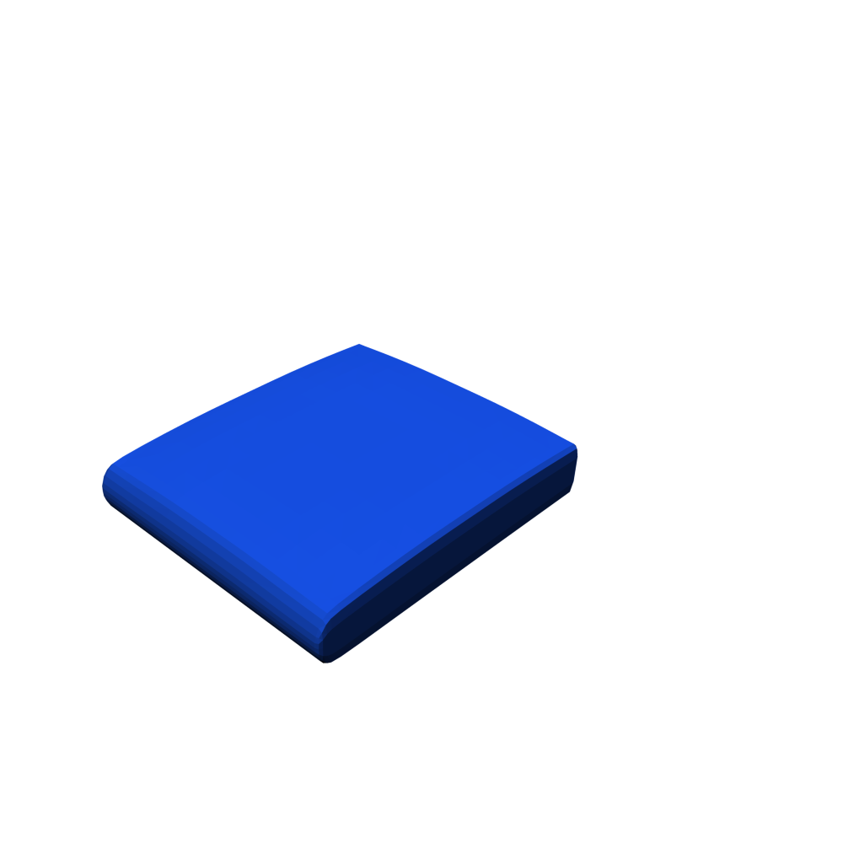
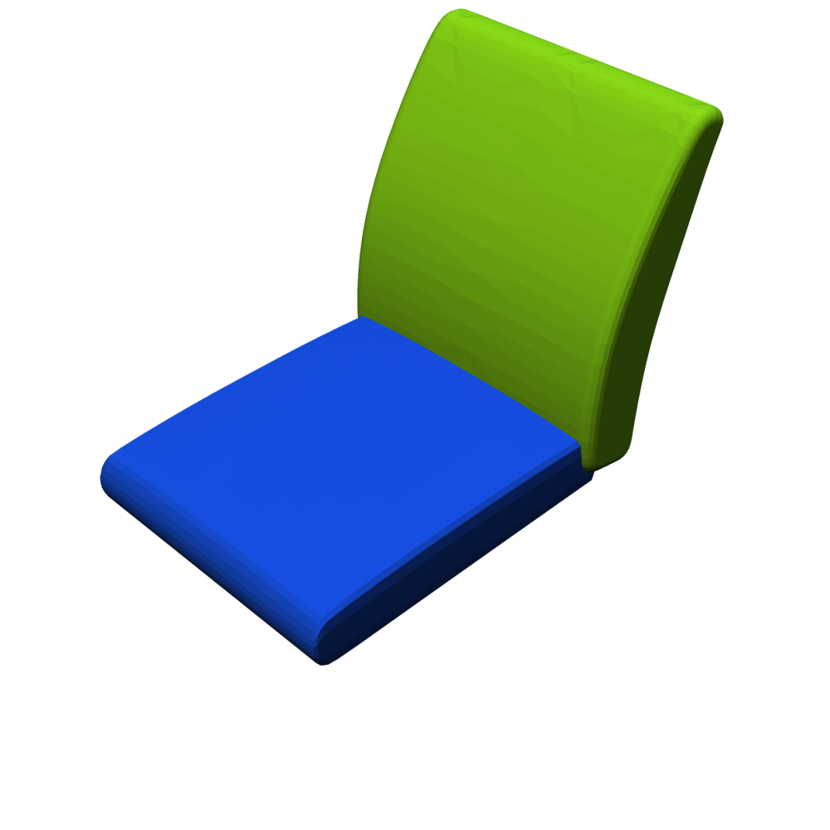
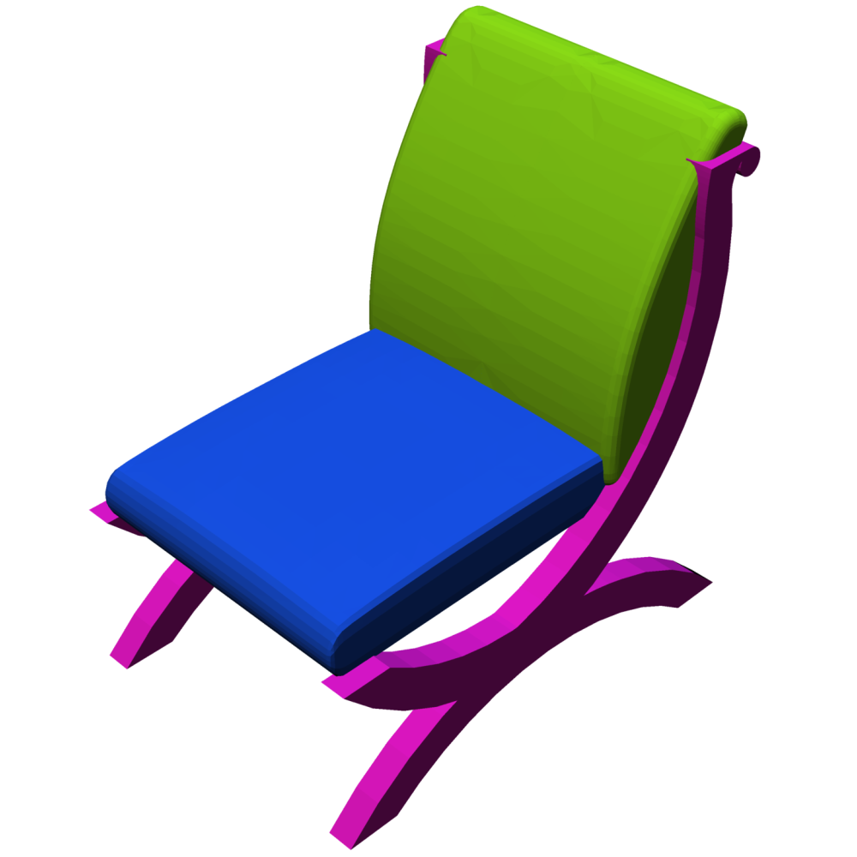
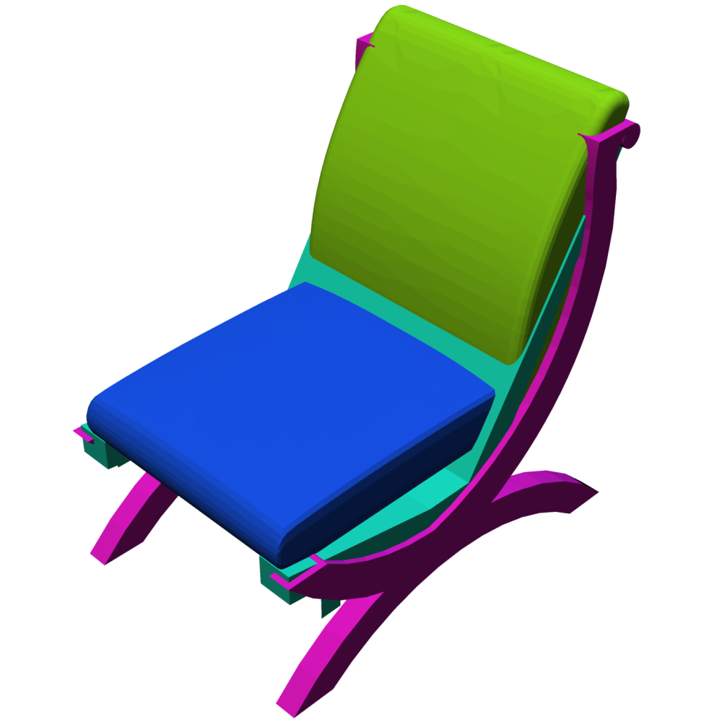
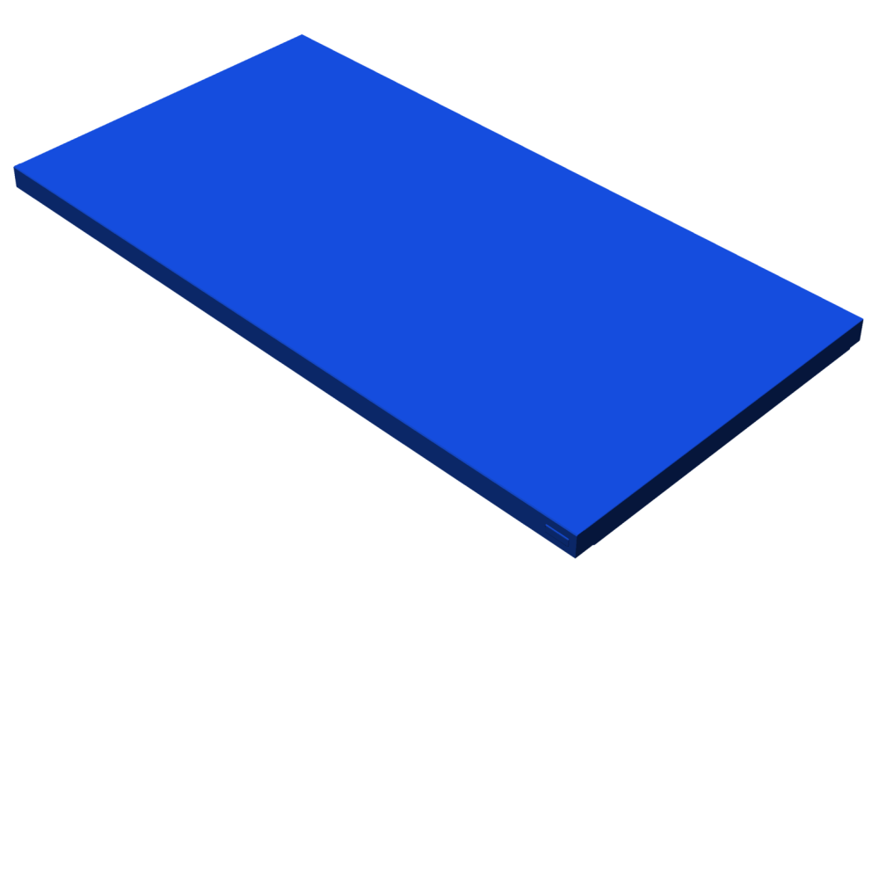
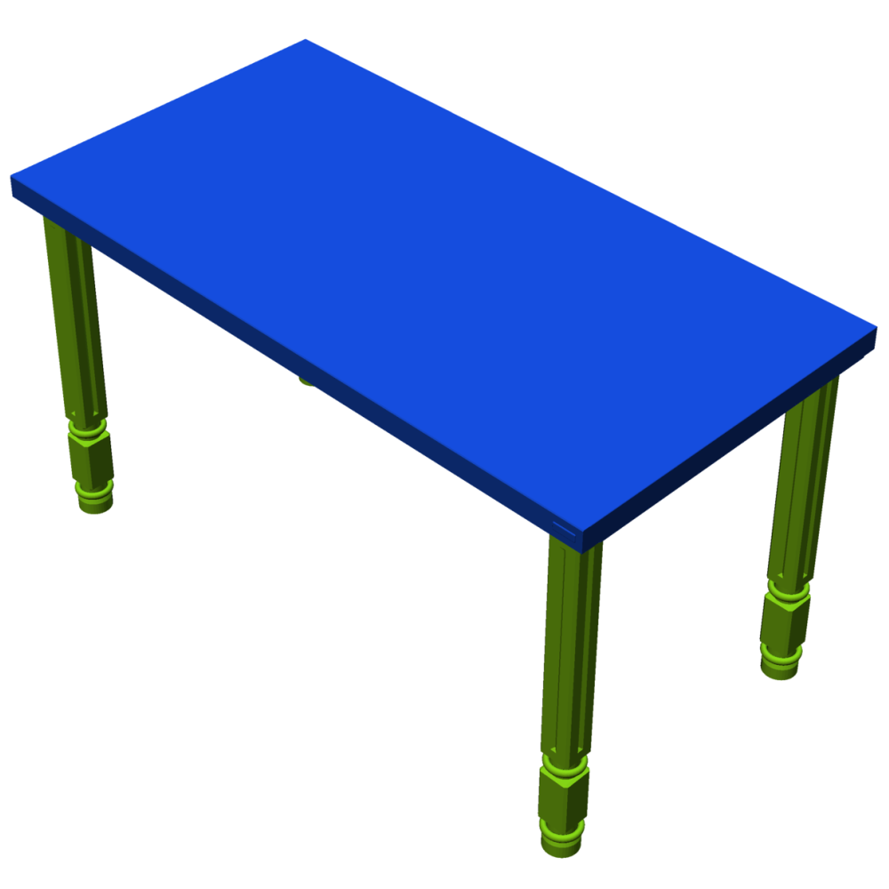
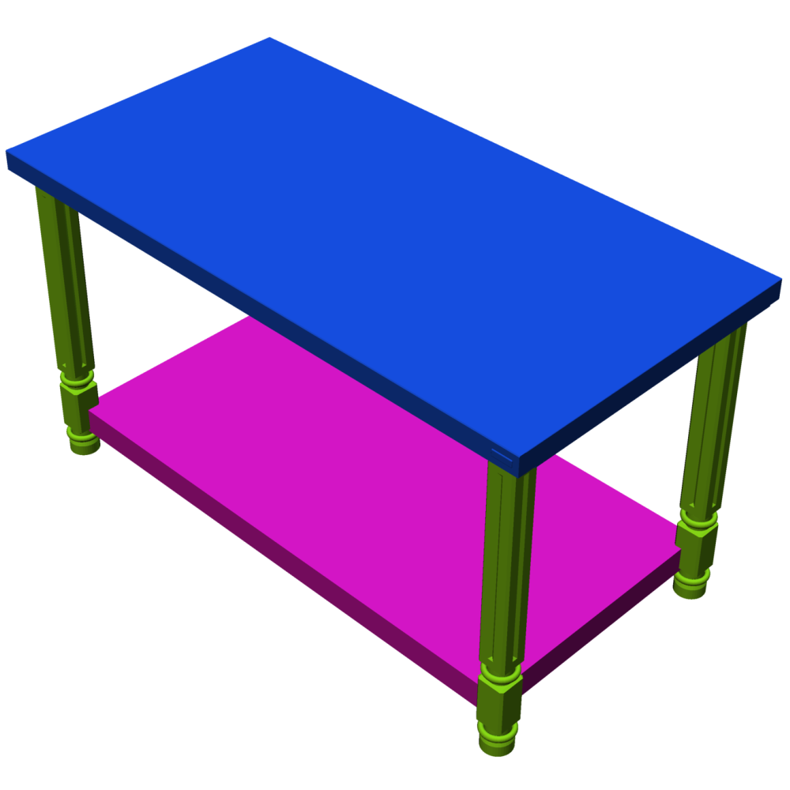
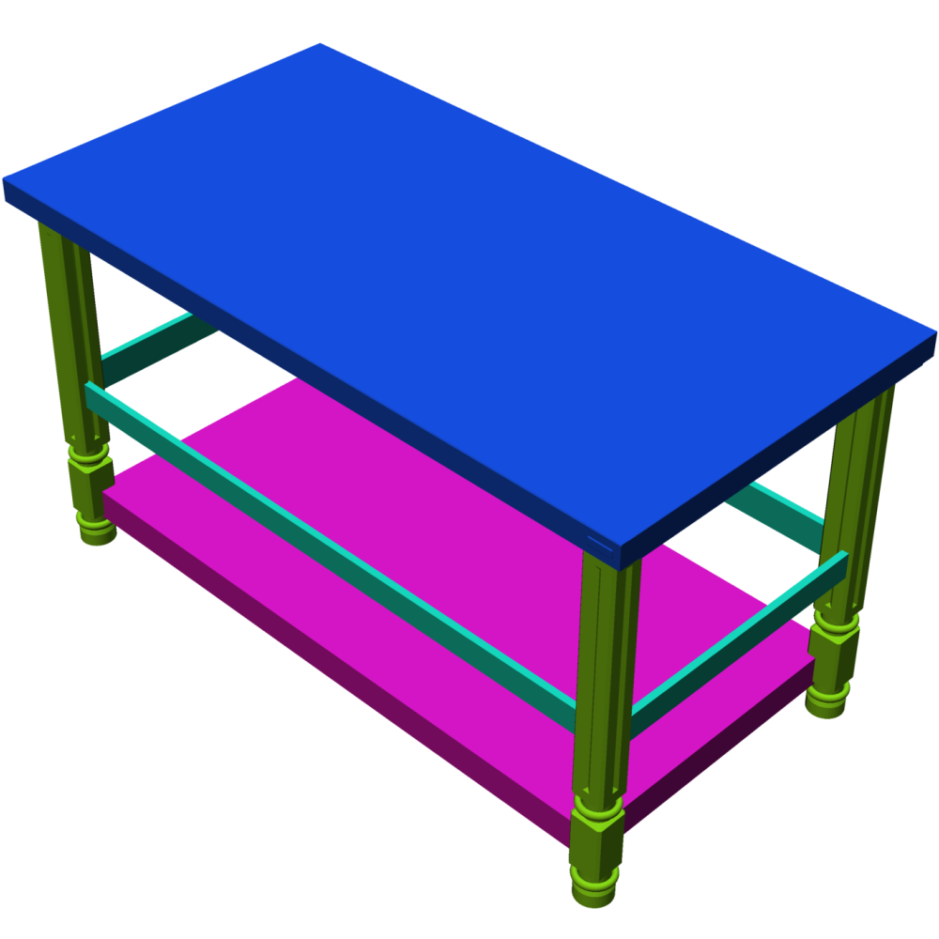
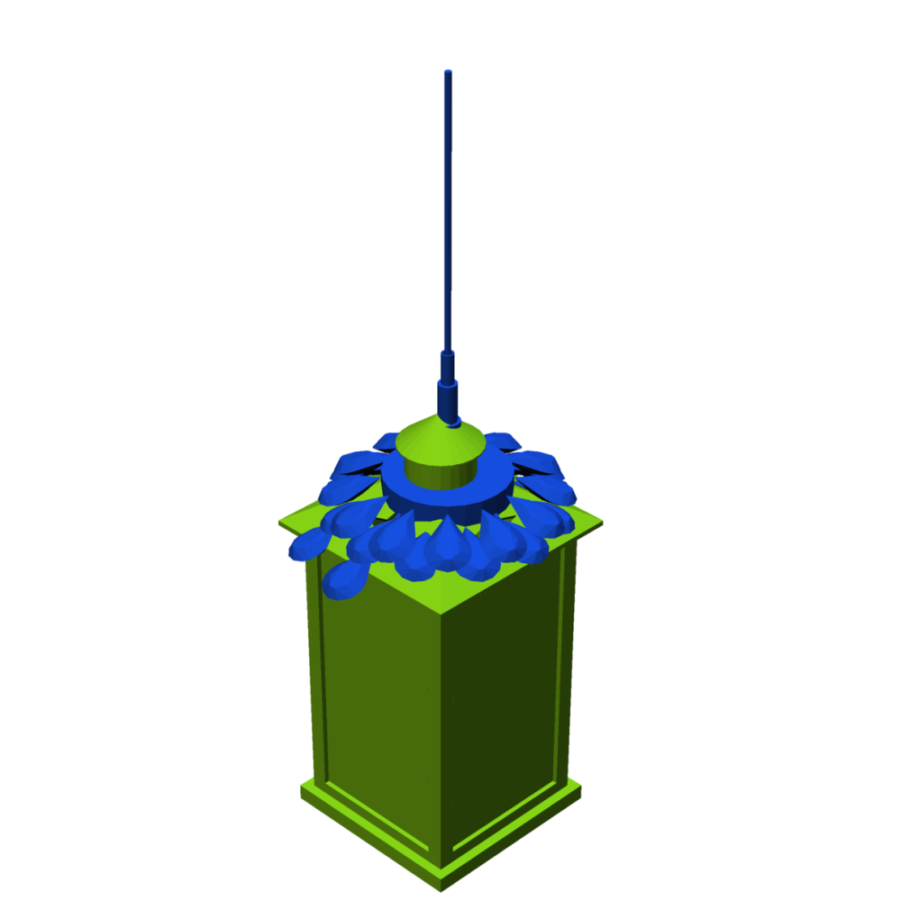
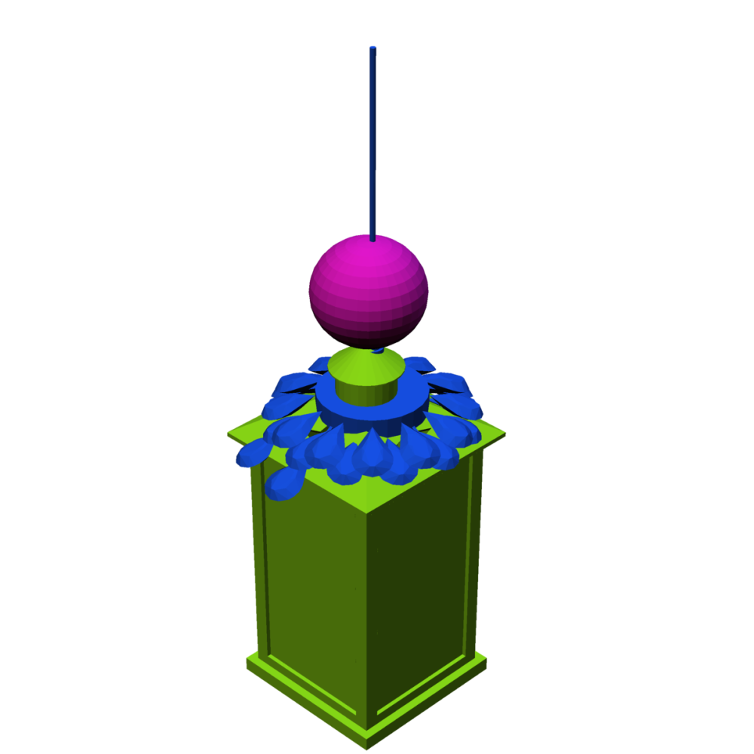
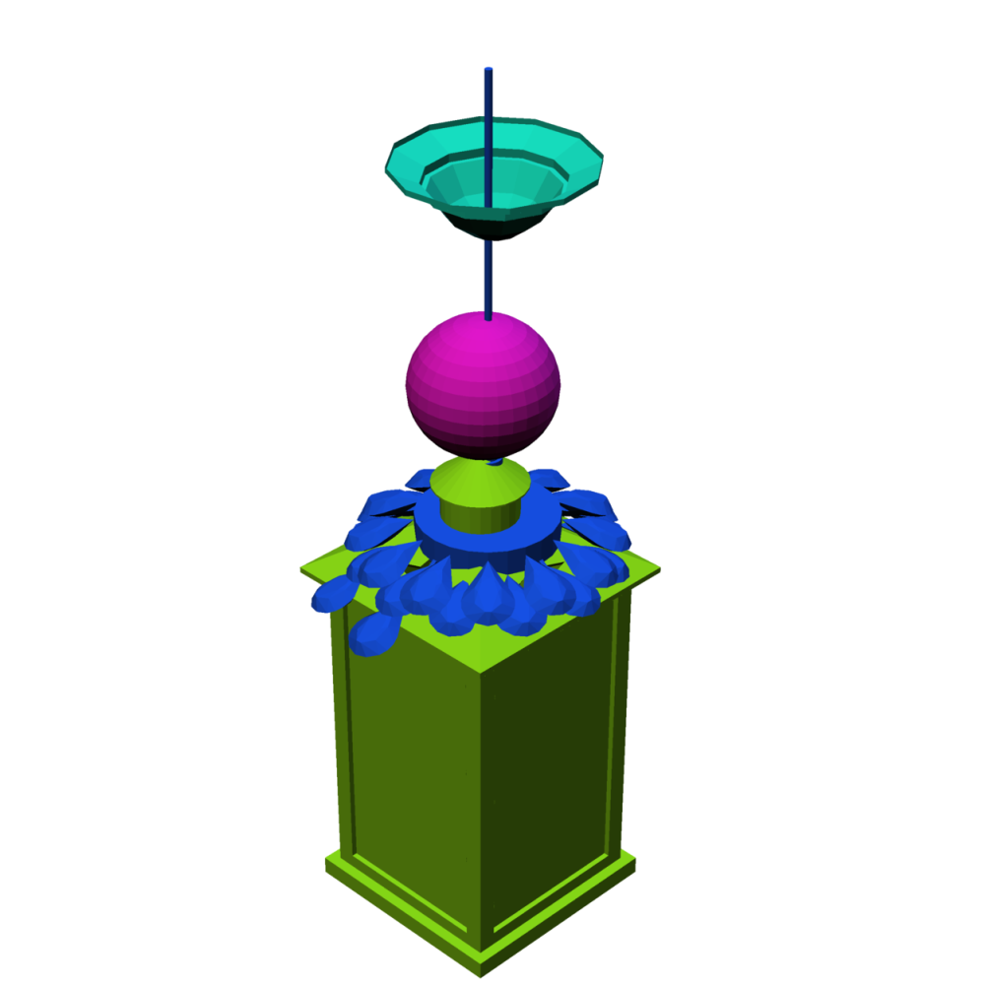
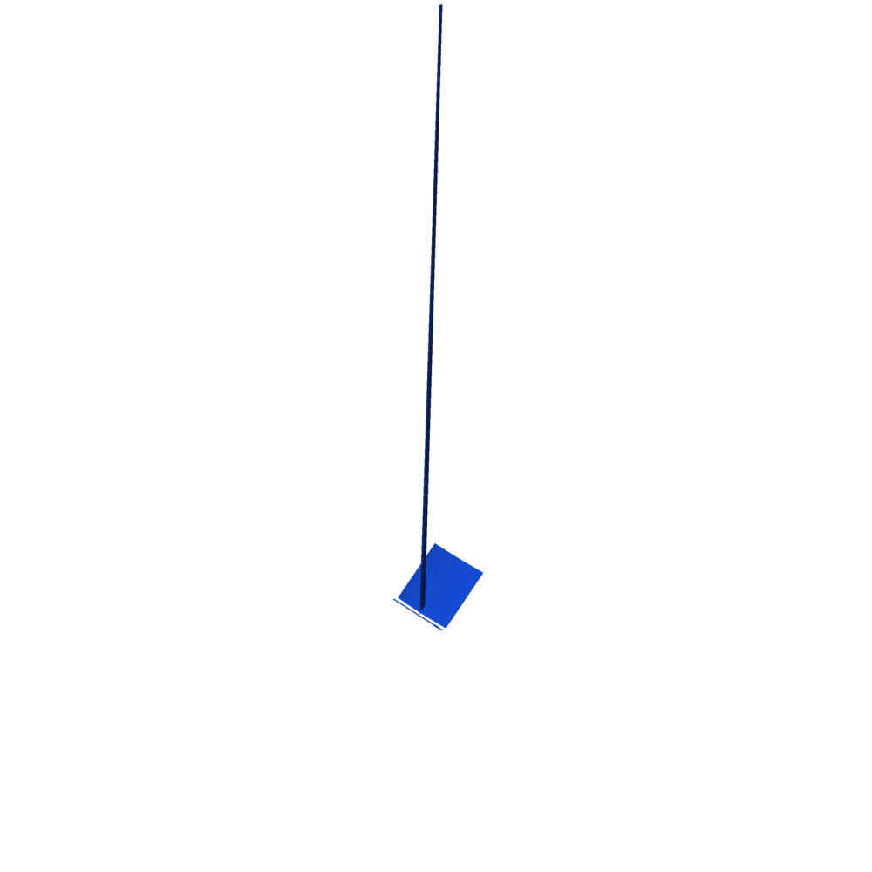
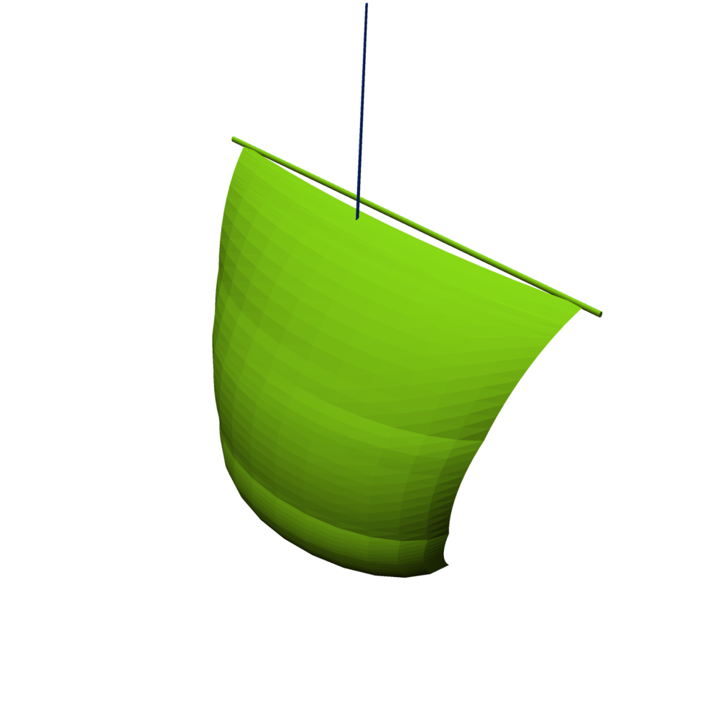
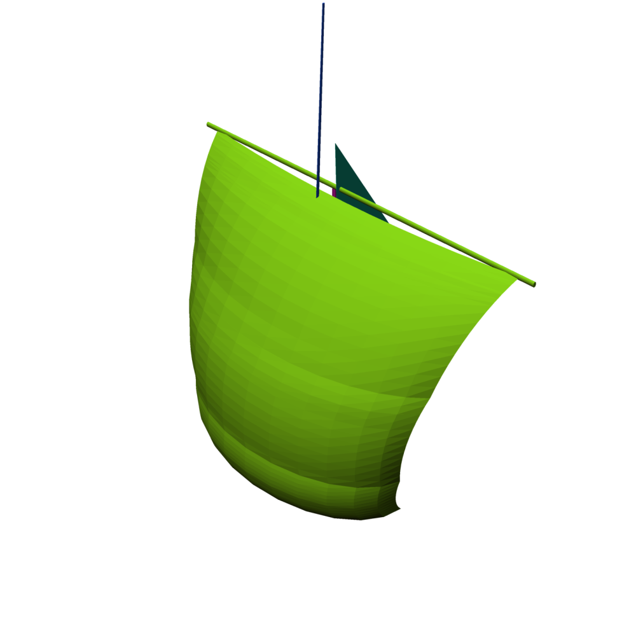
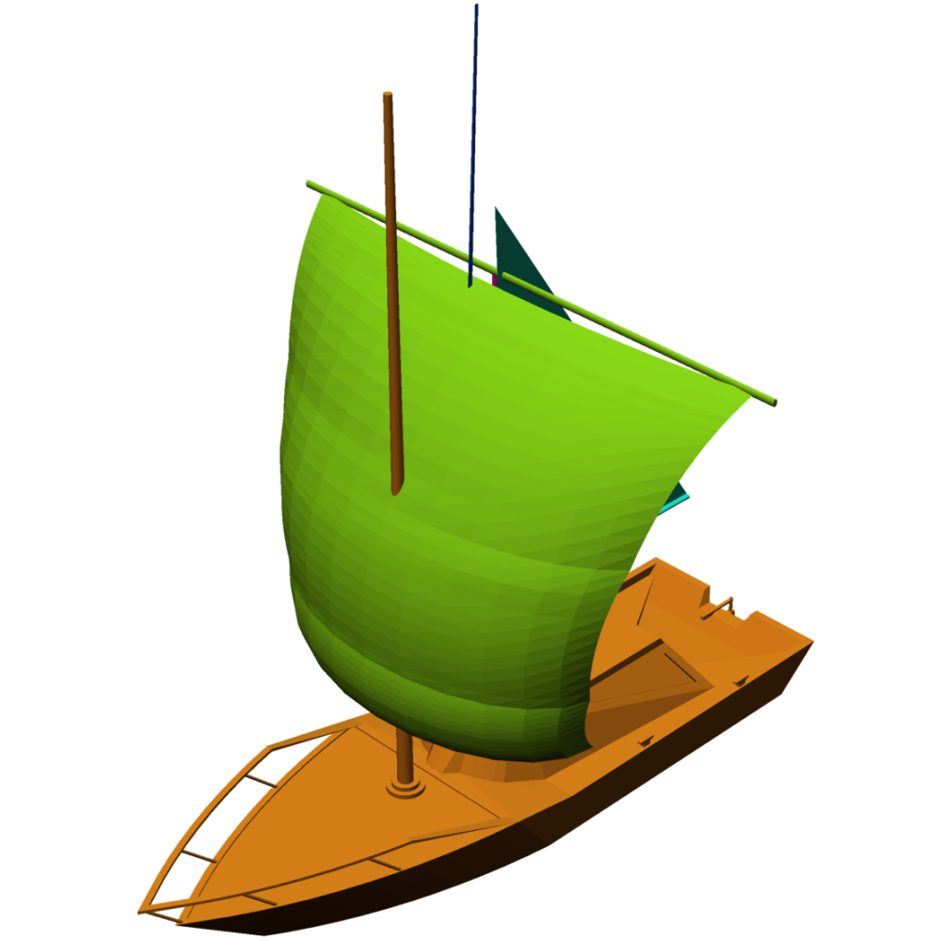
ComplementMe: Weakly-Supervised Component Suggestions for 3D Modeling
Minhyuk Sung¹, Hao Su^{1,2}, Vladimir G. Kim³, Siddhartha Chaudhuri⁴, Leonidas Guibas¹
¹Stanford University ²University of California San Diego ³Adobe Research ⁴IIT Bombay

Slide 2
Motivation
3D Modeling is time-consuming.
$×$200
https://www.youtube.com/watch?v=aS5KcO0etcM
Notes:
Geometric modeling is an essential for creating virtual 3D contents and designing real objects.
Yet, creating 3D modeling remains as a tedious and time-consuming task requiring specialized expertise.
----
https://www.youtube.com/watch?v=aS5KcO0etcM

Slide 3
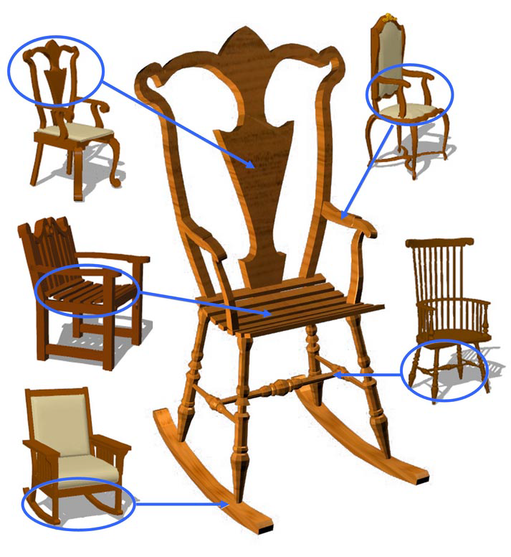
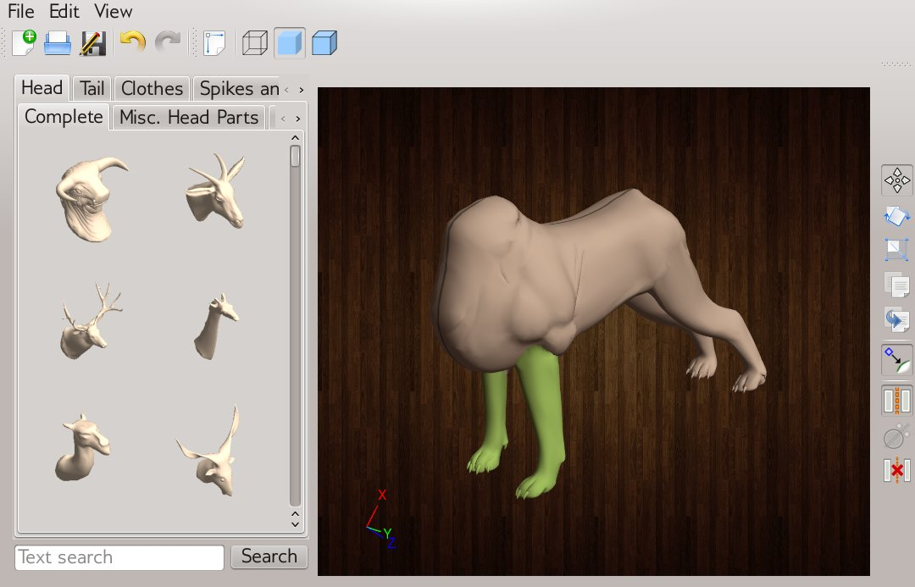
Motivation
Modeling by example [Funkhouser et al., 2004].
[Chaudhuri et al., 2011]
[Funkhouser et al., 2004]
[Kalogerakis et al., 2012]
Notes:
To allow non-expert users to create 3D shapes easily, previously a new idea has been introduced that reuses parts of existing 3D models and assembles them to synthesize a new object.

Slide 4
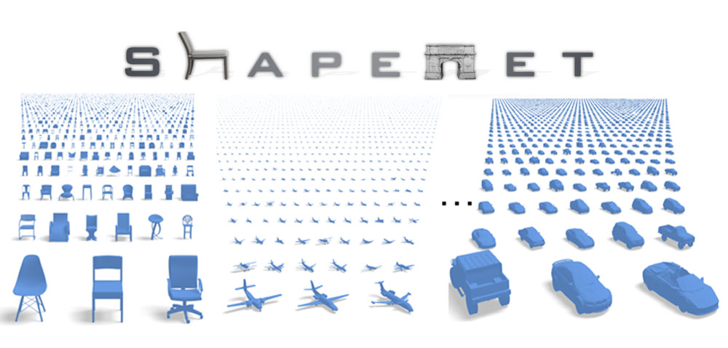
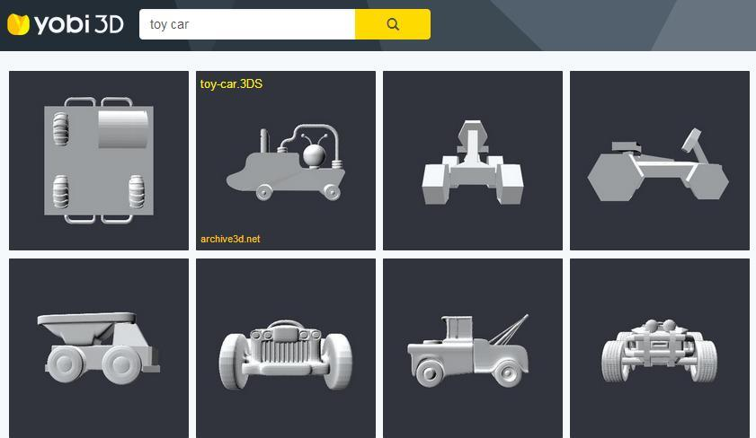
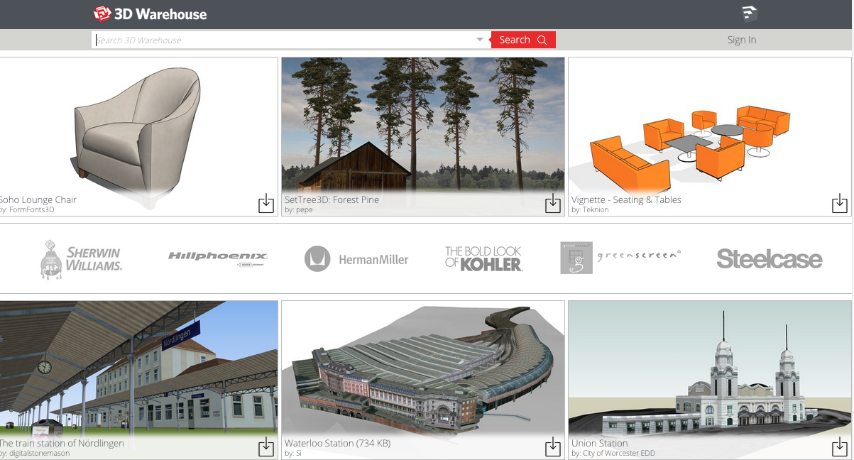
Motivation
Can be empowered by large-scale shape repositories.
Notes:
And now this idea can be more empowered by large-scale online shape repositories containing hundreds of thousands of shapes in diverse categories.

Slide 5
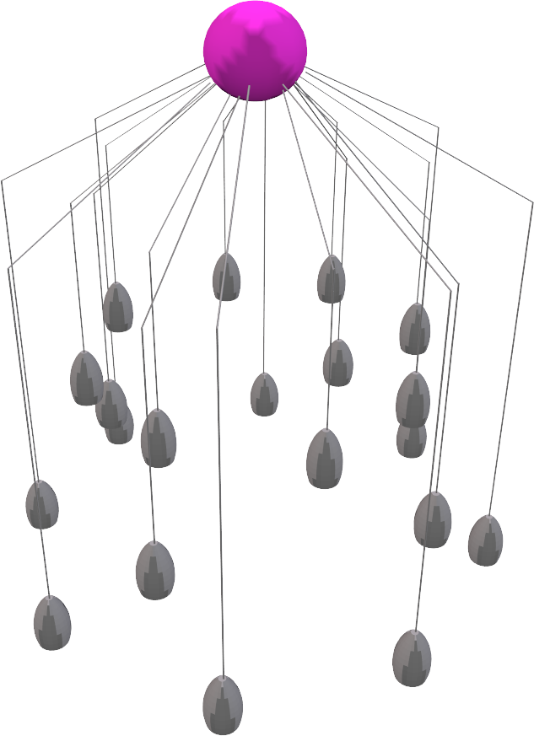
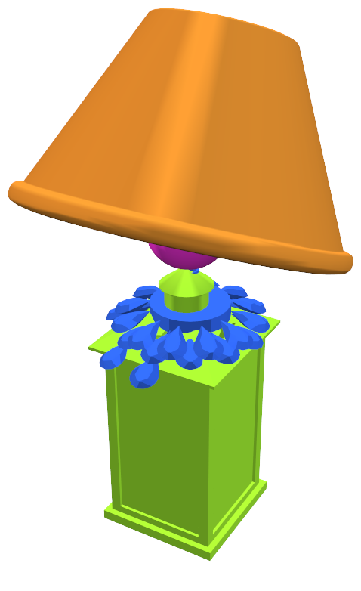
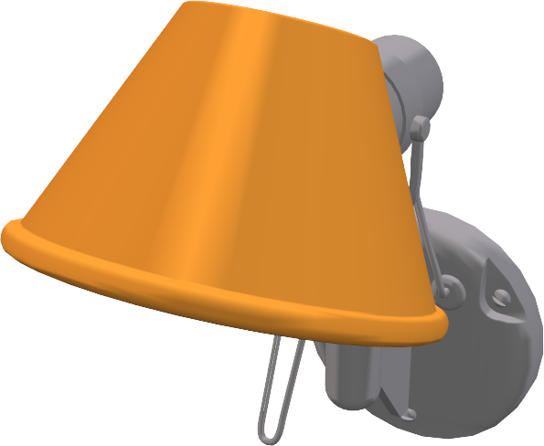
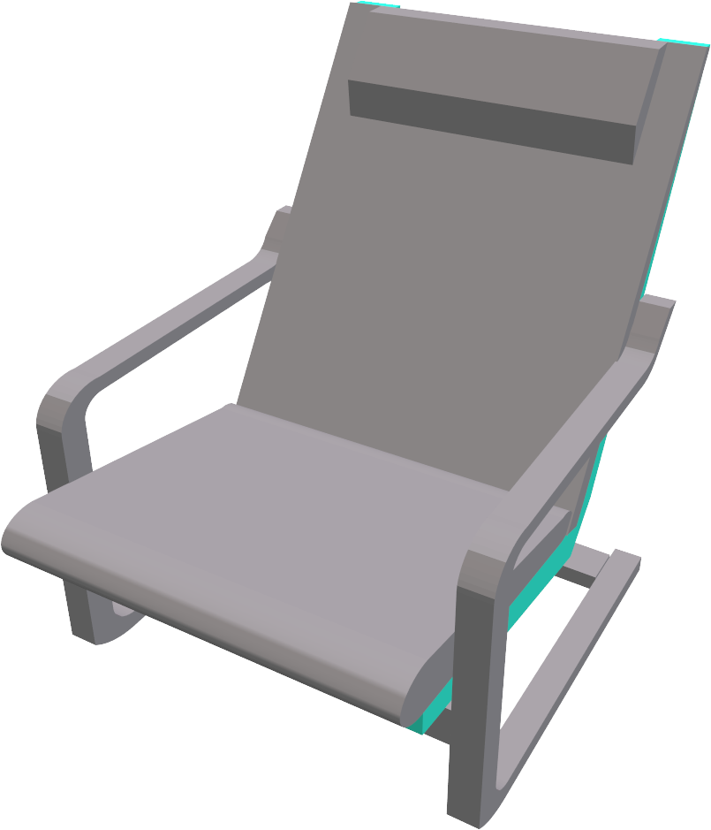
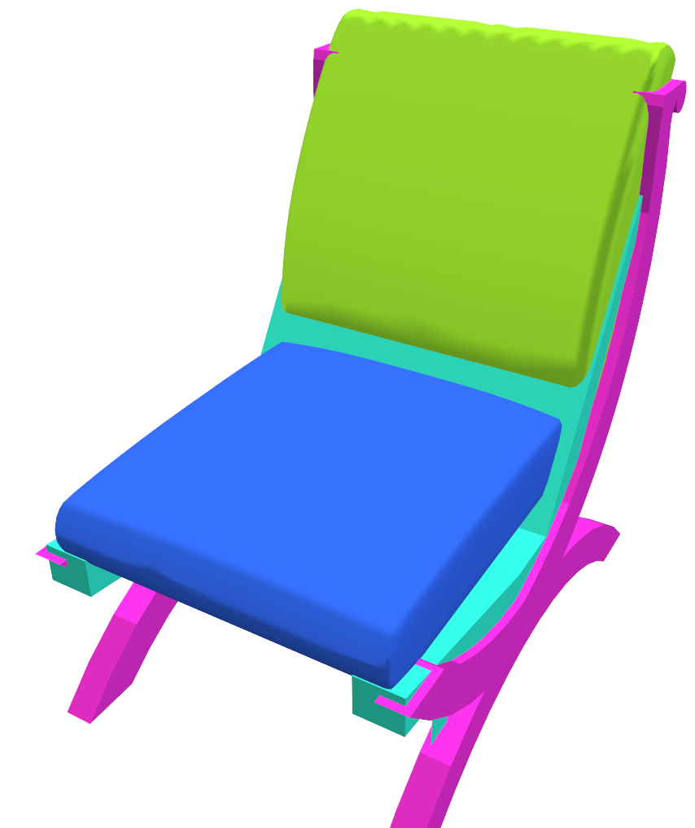
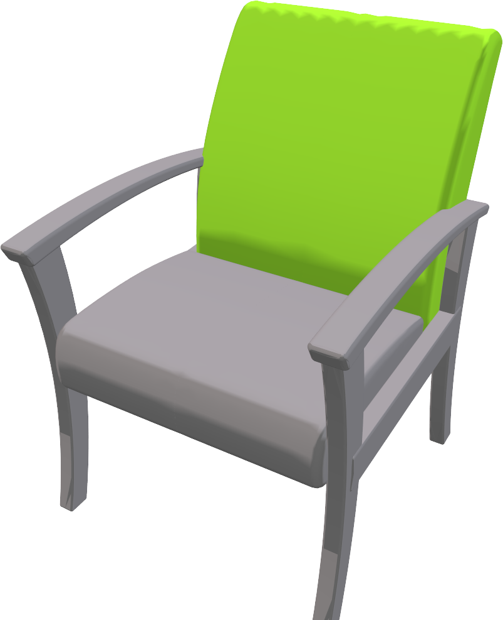
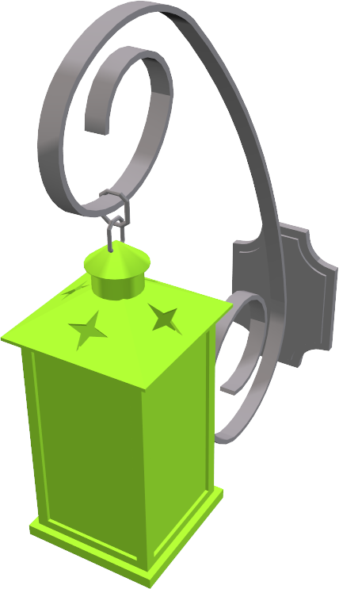
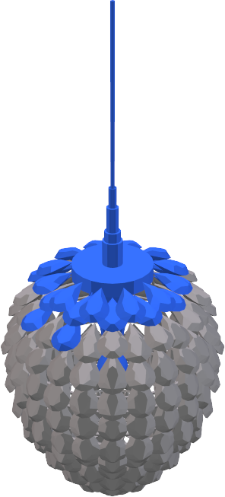
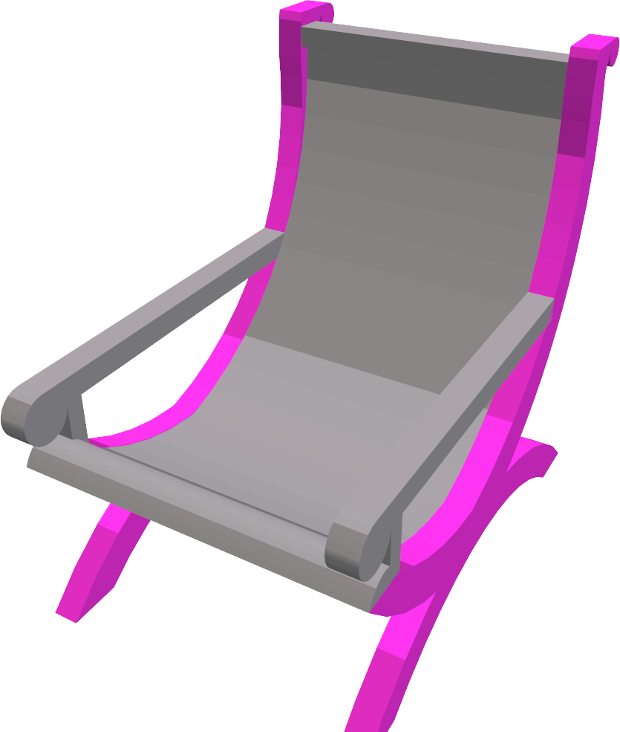
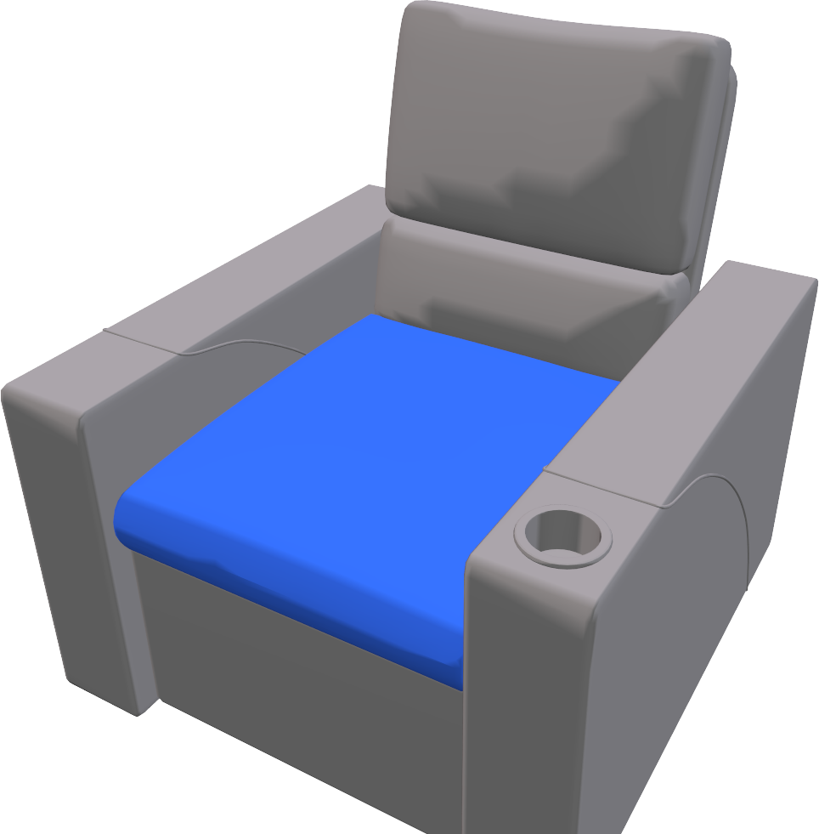
Goal
Create a shape by assembling components of 3D models in large-scale repository.
Notes:
In our project, we aim at creating new shapes by assembling parts in these large-scale repositories with a minimum amount of processing on raw data.
----
Best Chair 7495

Slide 6
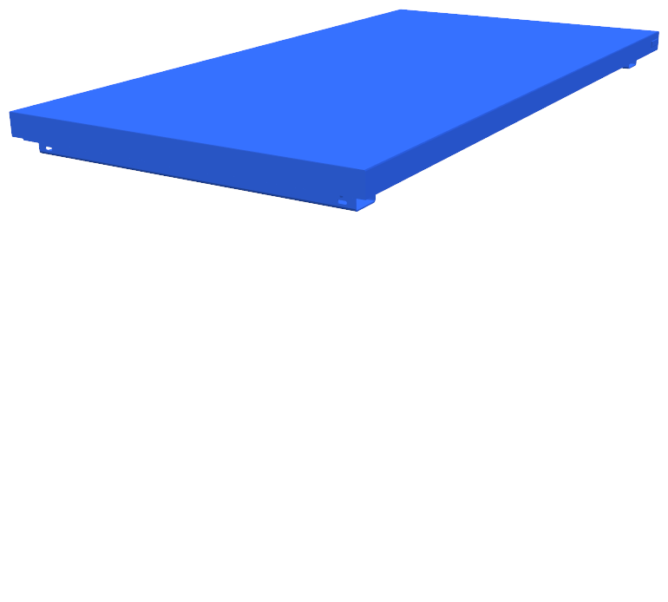
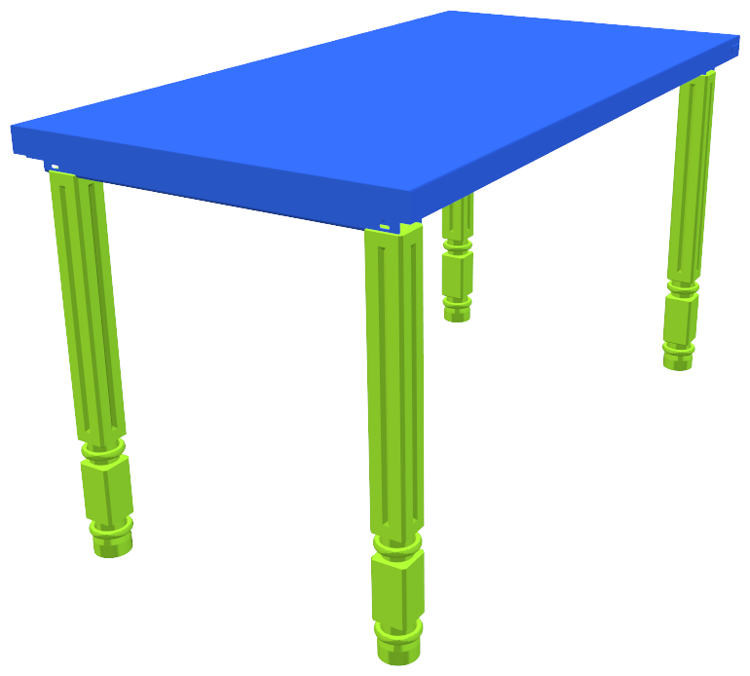
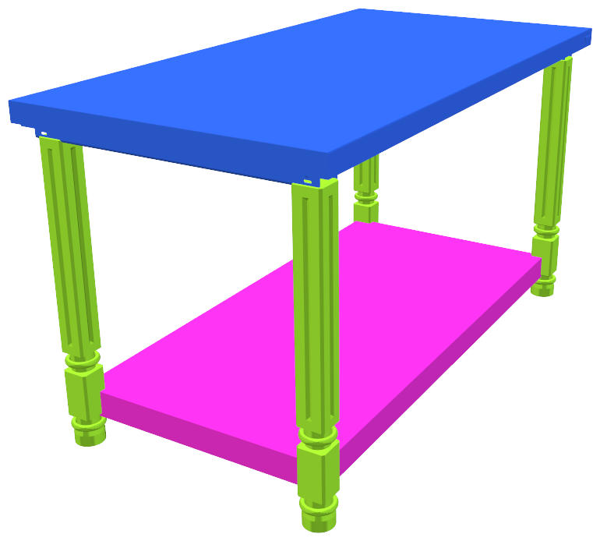
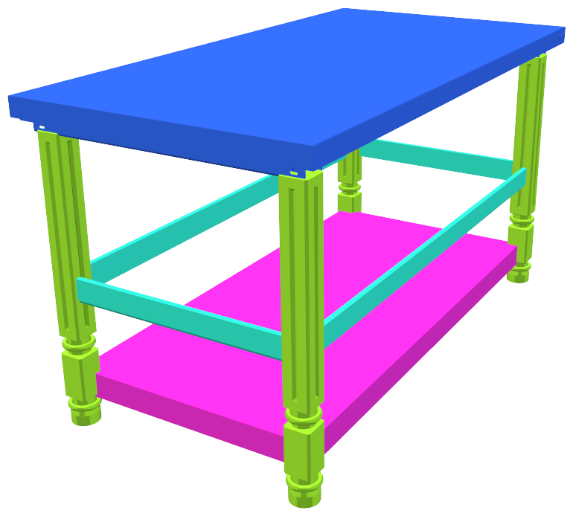
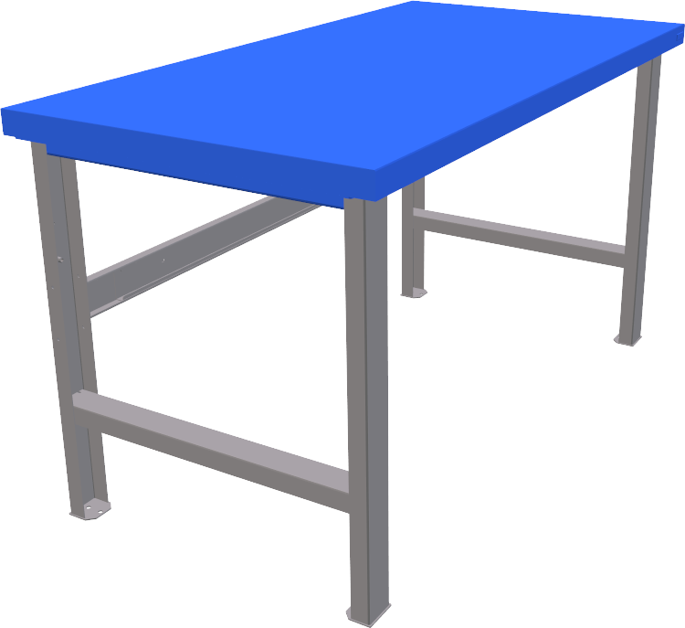
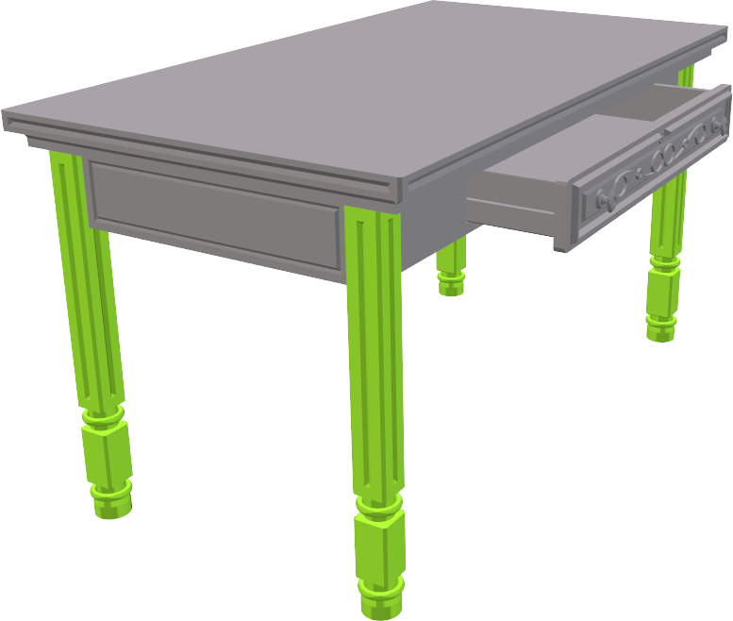
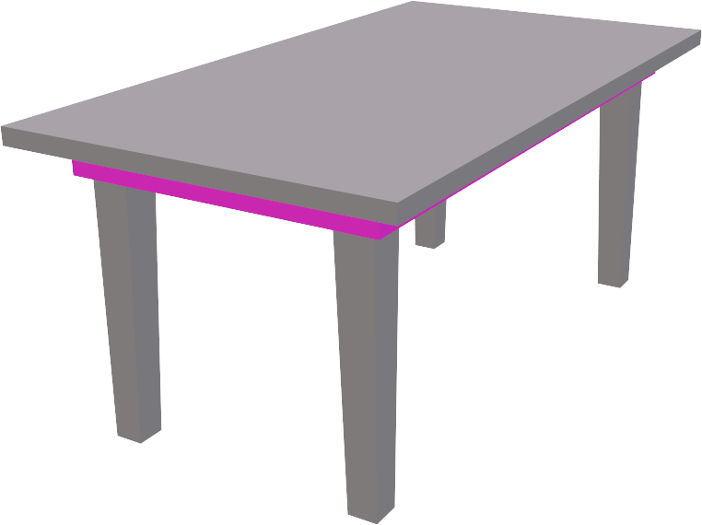
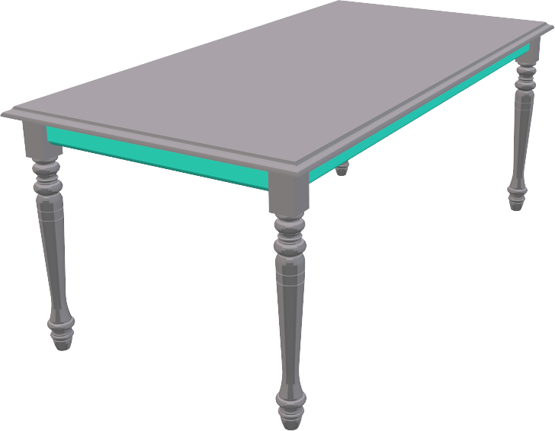
Goal
Create a shape by assembling components of 3D models in large-scale repository.
Suggest complementary components and their locations.
Notes:
Specifically, we propose an iterative assembly system. At each time, given a partial assembly of an object, our system provides complementary components that can better complete the shape, and also it predicts an appropriate position to place the new component.

Slide 7
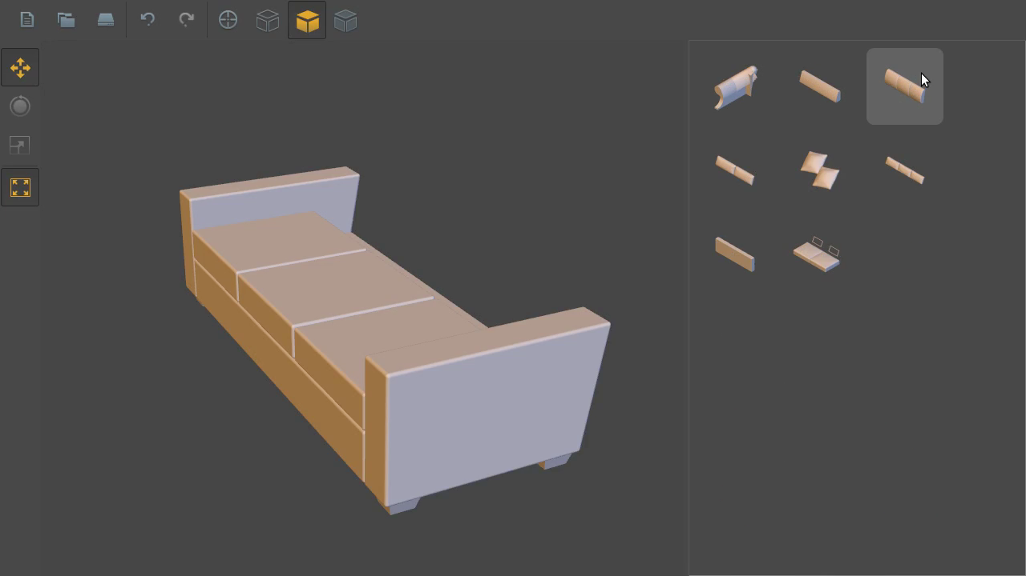
Goal
Automatic shape synthesis
Interactive design interface
Notes:
Our system of suggesting complementary components can be utilized in a fully automatic process of synthesizing shapes, and also can be integrated in an interactive design interface to allow users to have multiple choices at each step of assembly.

Slide 8
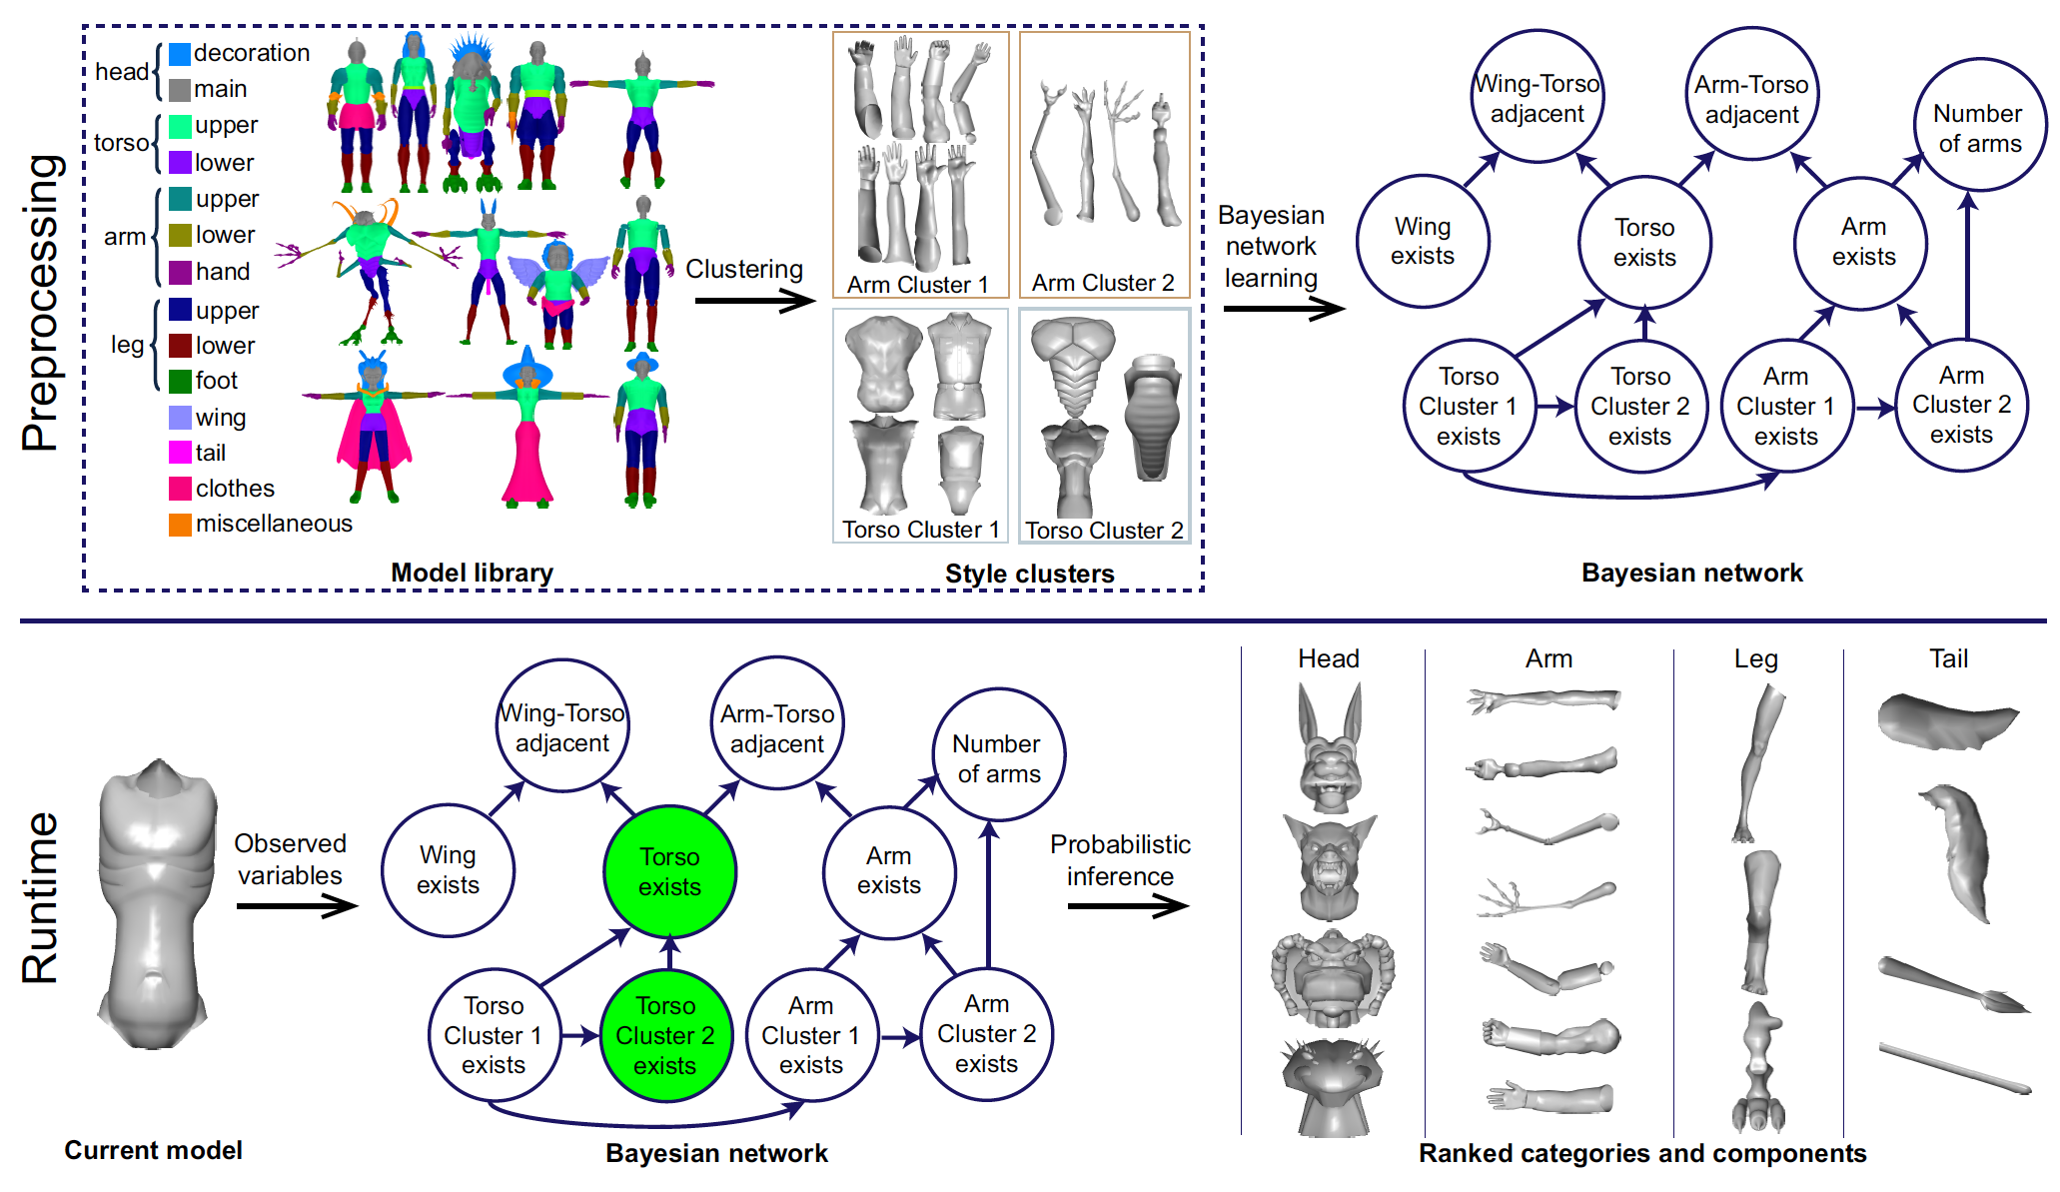
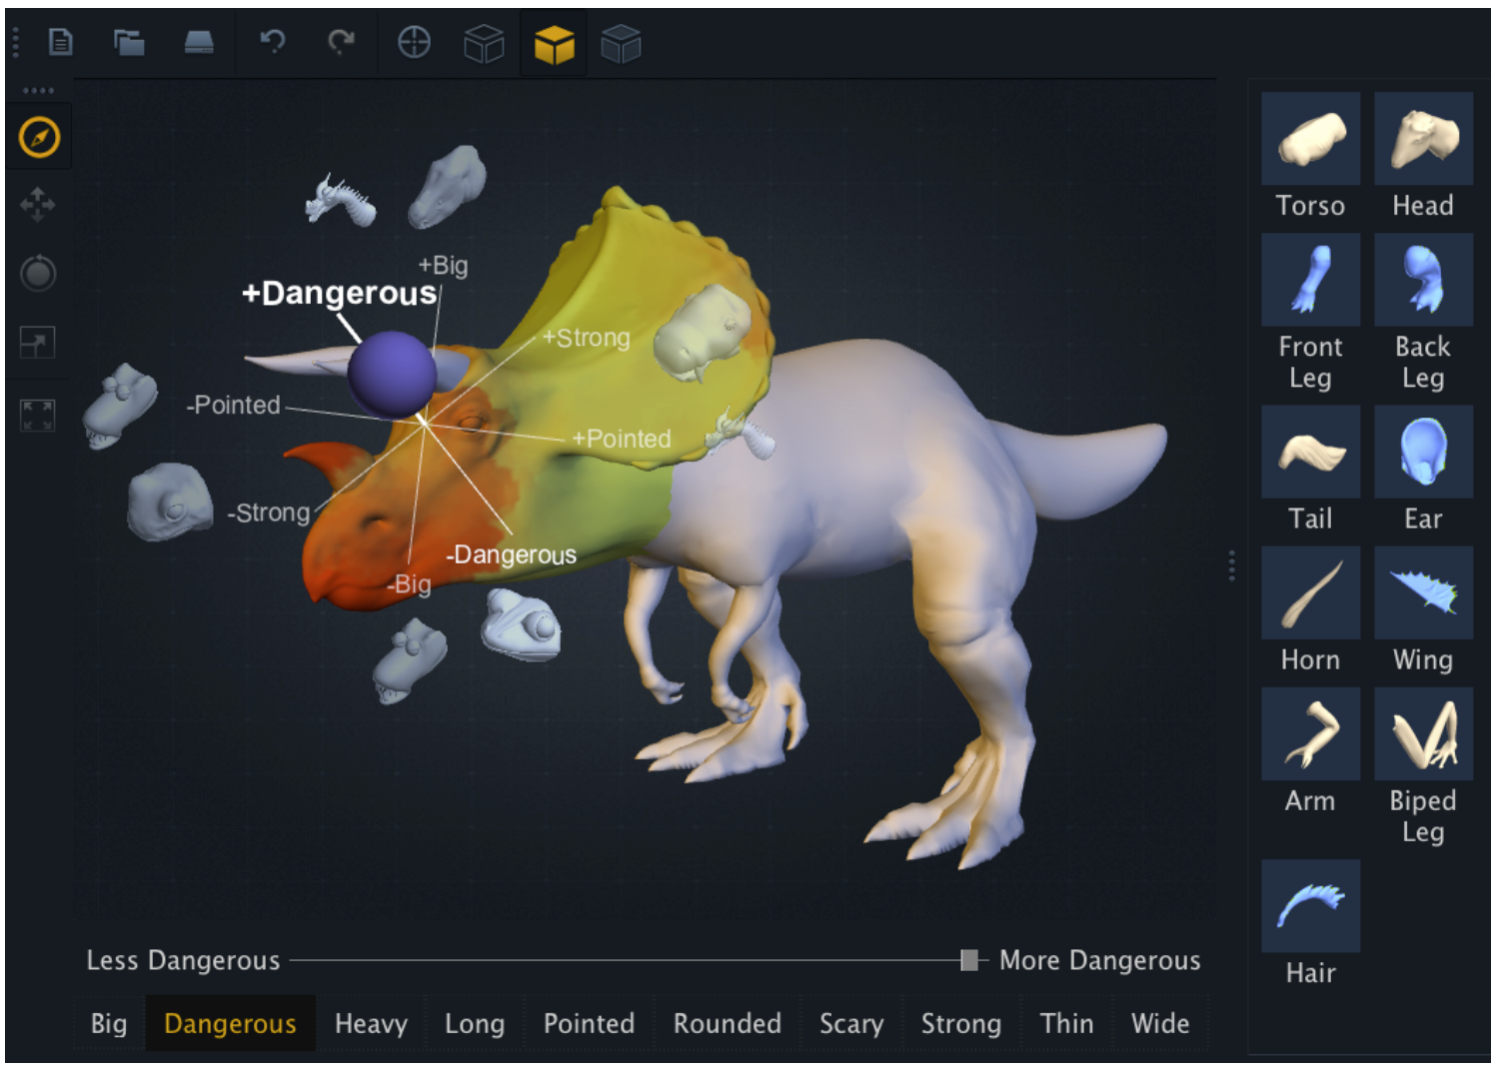
Challenges
Part labeling
[Chaudhuri et al., 2013]
[Chaudhuri et al., 2011]
Notes:
One of challenges of assembling components in the large-scale repository is to minimize the supervision and simplifying the preprocessing tasks.
Previous *assembly-based modeling works* required a heavy supervision on the dataset, mainly for segmenting shapes into parts consistently, and labeling them with semantic names.

Slide 9
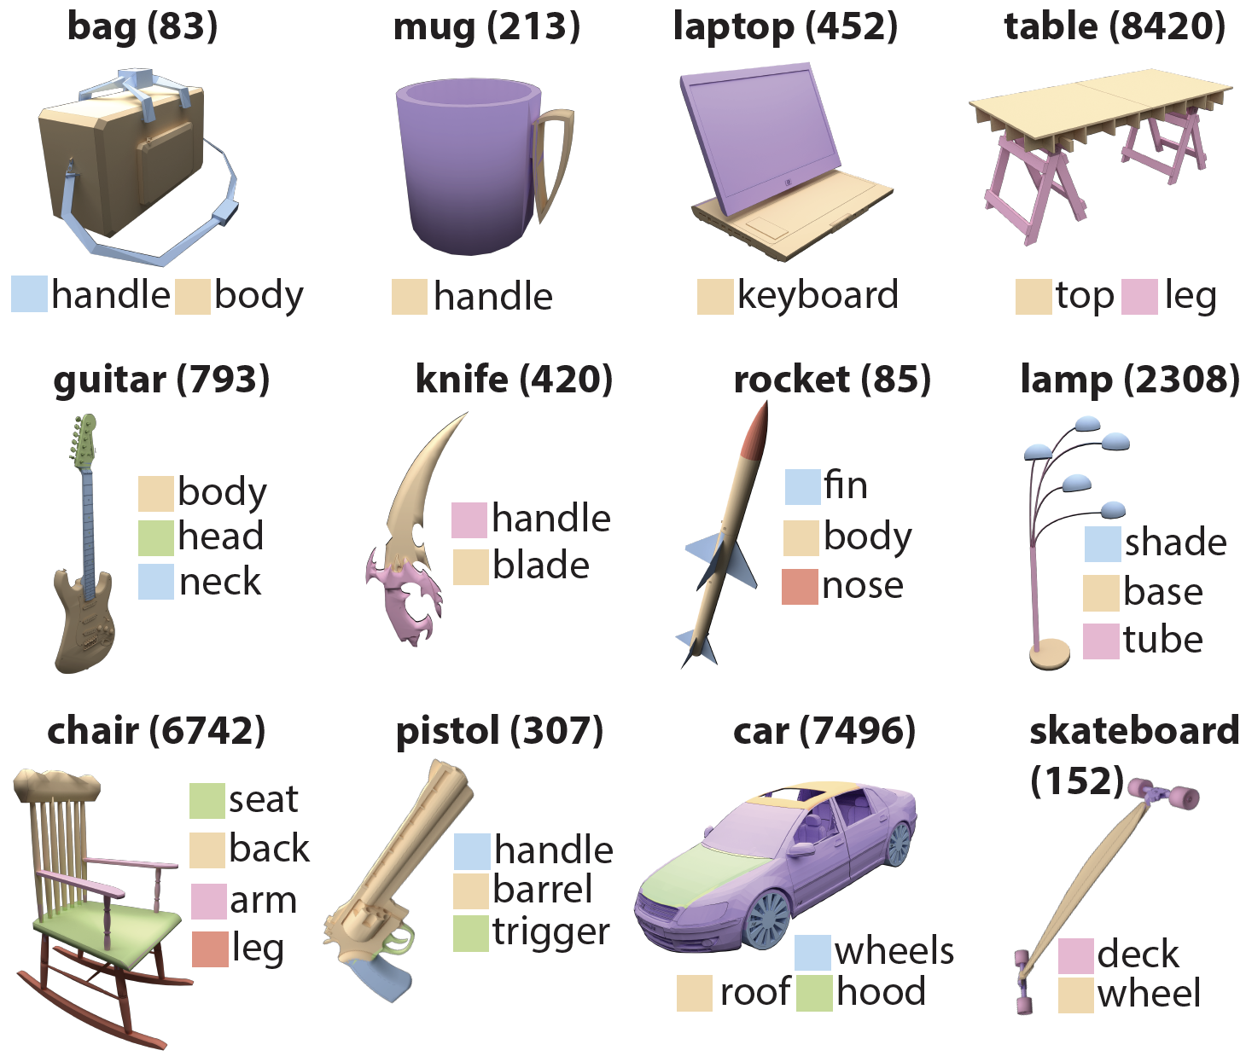
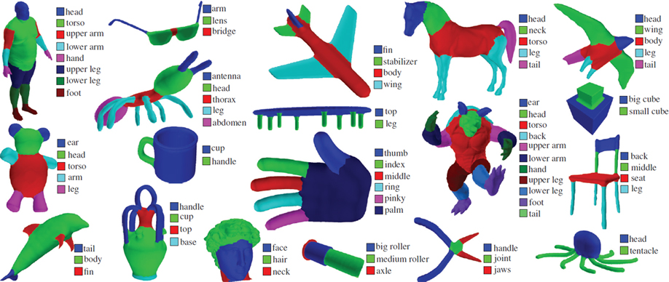
Challenges
Part labeling – Significant manual effort.
[Kalogerakis et al., 2010]
[Yi et al., 2016]
Notes:
And such preprocessing typically takes a huge cost of human annotations, and the burden can be substantially increased when the scale of database is growing.

Slide 10
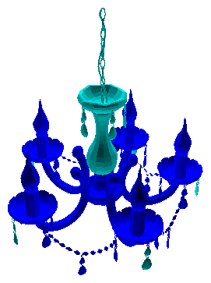
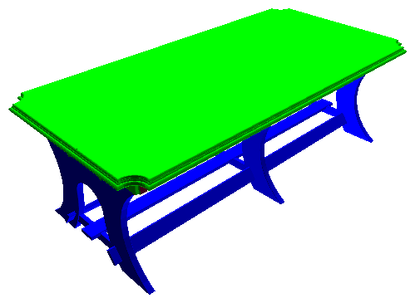
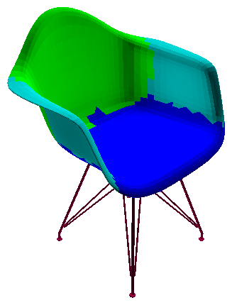
Challenges
Part labeling – Too coarse and imprecise at boundaries.
[Yi et al., 2016]
Notes:
Also, labeling itself is a non-trivial problem especially when trying to achieve fine-level annotations.
The set of labels need to be carefully selected and assigned to the segments while considering consistency over all shapes in the database.
Thus even the recent part label dataset provides only coarse-level part annotations with a few number of semantic labels.
Plus, sometimes the labeling process forcing to assign a given set of *labels to parts*
[click]
generates fuzzy boundaries among segments.
And this can lead to tricky mesh stitching problems when reusing the parts for assembly.
----
Lamp_3b64d5033c580d2ef76898f881b76a
Table_190028e65867076ee12186cc8c5022c7
Chair_1f8eaa7aededc7e637b2bb75885cfc44

Slide 11
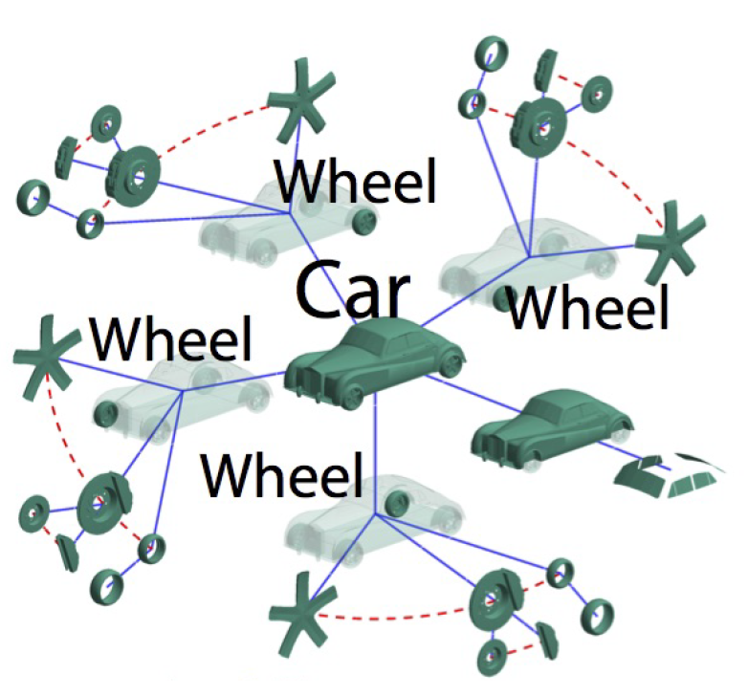
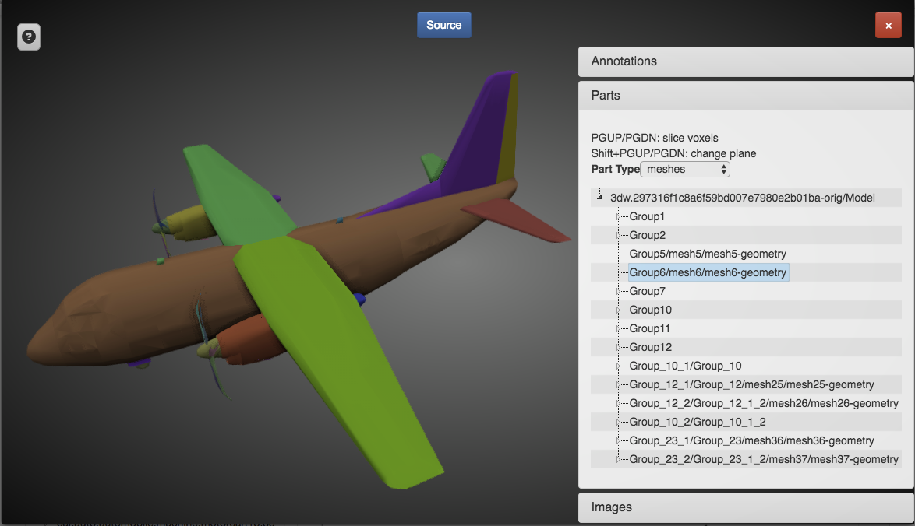
Observations
3D CAD models are mostly designed with a set of components (a scene graph) [Yi et al., 2017].
[ShapeNet]
[Yi et al., 2017]
Notes:
In our work, instead of relying on the previous part label datasets, we leverage the observation that actually designers also produce 3D models by first creating each component, and then organizing the components in the space.
And fortunately, most 3D CAD models in the online repositories contain the component structure information called scene graph.

Slide 12
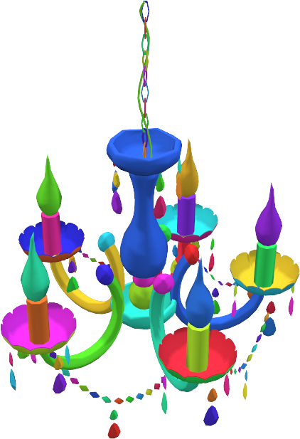
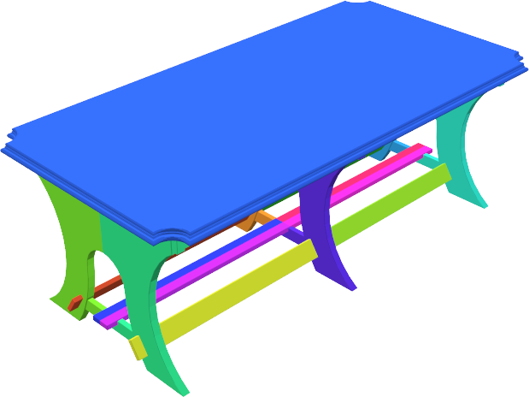
Observations
($+$) Provides natural part segmentations.
Notes:
The component structure information stored in the CAD models mostly provides a natural segmentation of objects even with clear boundaries among the components.
----
Lamp_3b64d5033c580d2ef76898f881b76a
Table_190028e65867076ee12186cc8c5022c7
Chair_1f8eaa7aededc7e637b2bb75885cfc44

Slide 13
Observations
($+$) Provides natural part segmentations.
($−$) Inconsistent and often unlabeled.
Notes:
But it typically lacks of semantic labels, and also does not guarantee any consistency in the granularity of segmentation across the shapes.
----
10e99b1475098c0aaa69dfdc5532bb13
15c3b923c85d22796d8b9531f93cc8de
12cd99c20b1a5a932e877e82c90c24d

Slide 14
Challenge
Multiple complementing parts are possible for the same partial input.
Query
Notes:
This makes another challenge in our project.
When we use the given part segmentation existing in the CAD models without any semantic labels, it’s not possible to specify the order of assembly.
For instance, given a seat of a chair,
[click]
we can add a back of chairs,
[click]
or legs of chairs, even in different styles,
[click]
or a bigger component containing both of them.

Slide 15
Our Approach
Retrieval: Predict a multi-model probability distribution over the component embedding space.
Retrieval Network
Embedding Network
Partial Assembly
Probability
Distribution
Component Embedding Space
Notes:
To address this challenge, given a query partial assembly we do not retrieve a single best complementary part, but we predict a multi-modal probability distribution over the component embedding space, and we sample the new component based on the predicted distribution.
Here
[click]
we design the embedding and retrieval functions with neural networks and jointly train them with the segmented 3D shapes in the database.

Slide 16
Our Approach
Placement:
Predict the location of the selected component.
Embedding Network
Placement Network
Probability
Distribution
Component Embedding Space
Output
Notes:
Once the next component is sampled from the distribution, we use another *neural network that we call placement network* to predict the position of new component.

Slide 17
Outline
Data Preprocessing
Retrieval / Embedding Network
Placement Network
Notes:
[04:40]
Now let me explain our approach in details.
I’ll describe our data preprocessing step, and the design of retrieval, embedding, and placement neural networks.

Slide 18
Outline
Data Preprocessing
Retrieval / Embedding Network
Placement Network
Notes:
In the data preprocessing step,

Slide 19
Data Preprocessing
Merge raw components into a single component.
Build a contact graph of components.
Notes:
we extract component information from scene graphs,
[click]
merge the components into a single component,
[click]
and build a contact graph of the grouped components.

Slide 20
Data Preprocessing
Why build a contact graph?
To suggest connected components at each step.
$$×$$
Notes:
The reason why we build a contact graph of components is because we want to suggest components in the assembly that can be connected to the given partial shape.
And this is obviously a natural way of assembling components incrementally.
So we consider a graph which nodes represent the components, and the edges indicate the connectivity of the components.

Slide 21
Data Preprocessing
Random partial shape and complement sampling
Partial shape: A subgraph.
Complement: Any connected component.
Complement
Complement
Notes:
And in our system, we assume that the input shape is a subgraph of the contact graph, and *a plausible output part* is a node connected to this given subgraph.
Based on this assumption, in the training of the neural networks, we populate the training data by randomly generating pairs of a random subgraph and one of its connected node.

Slide 22
Data Preprocessing
Merge raw components into a single component.
Group identical components.
Notes:
And before we create the contact graphs of the components, we first merge raw components in the *scene graph* with some reasons.
First, we need to preserve the symmetry structure in the assembled objects.
[click]
So we group identical components into a single component.

Slide 23
Data Preprocessing
Merge raw components into a single component.
Group identical components.
Group overlapped or too small components.
Notes:
Second,
[click]
sometimes we see highly overlapped components in the raw data,
and we group them together since it can help to predict complementary parts that fill the missing area not the occupied space.
Lastly,
[click]
tiny components do NOT make any meaningful difference in the global structure of the object, so we group too small components with their neighbors.

Slide 24
Outline
Data Preprocessing
Retrieval / Embedding Network
Placement Network
Notes:
[06:30]
Now let me explain our retrieval and embedding networks.

Slide 25
Retrieval and Embedding
Given a partial assembly, find plausible complementary components.
Partial Assembly
Plausible complementary components
Notes:
At each step of assembly, our retrieval network basically finds plausible complementary components given a partial assembly.

Slide 26
Retrieval and Embedding
Map both components and the query shape to an embedding space, and find the nearest neighbors.
Retrieval function
Embedding function
1D embedding example
Notes:
And for efficiency of retrieval in a large-scale database,
we consider
[click]
a low dimensional embedding space of components,
[click]
and precompute the mapping from all components in the database to the embedding space.
[click]
Then, we predict an embedding coordinate from the input partial assembly, and finally retrieve components with a nearest neighbor search.

Slide 27
Retrieval and Embedding
There exist multiple candidates.
$⟹$ Predict a probability distribution over the space.
Retrieval function
$$𝒩(μ_{1},σ_{1}^{2})$$
$$𝒩(μ_{2},σ_{2}^{2})$$
$$𝒩(μ_{3},σ_{3}^{2})$$
1D embedding example
Notes:
But, we do not have a single best answer. Actually
[click]
multiple components can be good choices as next complementary parts.
And it is also important to provide diverse candidates in the designing process.
[click]
Thus, we solve this one-to-N mapping problem by predicting a probability distribution over the embedding space.
Here, obviously the distribution is expected to have multiple peaks.
[click]
So, we model the distribution as a Gaussian mixture, and predict the parameters with the retrieval function.
----
A770cb6ad4a97df84abd45348d17aaf8,3
7e7e130acfcdf64b1dec8546fd5980a9,1
3b5364e2f1624ef992979c651b40698c,2

Slide 28
Joint Training
$$φ$$
$k$ weights
X
Retrieval
Function
$$μ$$
$k$ means
$$σ$$
$k$ stdevs
Loss: Negative log likelihood
Y
Embedding
Function
Yc
$$E\left(X, Y\right)=−\log{P\left(Y | X\right)}$$
$$P\left(Y | X\right)=\sum_{k}{φ_{k}(X)𝒩(μ_{k}\left(X\right),{σ_{k}(X)}^{2})}$$
Notes:
This is the outline of the training step.
[click]
For every pair of random partial assembly and one of its complementary part,
the retrieval function predicts
[click]
a set of Gaussian distribution parameters with weights.
And the embedding function predicts
[click]
the embedding coordinates of the complementary part.
[click]
Then, both functions are trained to minimize the negative log likelihood.

Slide 29
Joint Training
Can use any off-the-shelf
3D neural network architecture.
Mesh → Point cloud
$$φ$$
$k$ weights
X
Retrieval
Function
PointNet
[Qi et al., 2017]
$$μ$$
$k$ means
$$σ$$
$k$ stdevs
Loss: Negative log likelihood
Y
Embedding
Function
PointNet
[Qi et al., 2017]
Yc
$$E\left(X, Y\right)=−\log{P\left(Y | X\right)}$$
$$P\left(Y | X\right)=\sum_{k}{φ_{k}(X)𝒩(μ_{k}\left(X\right),{σ_{k}(X)}^{2})}$$
Notes:
And here, we leverage the recent neural network techniques.
[click]
For both retrieval and embedding functions, we can use any off-the shelf 3D neural network architecture.
[click]
We specifically use PointNet architecture that takes a point cloud as inputs.
[click]
And we sample points on the mesh surface to feed the network.
This neural network structure actually needs one more thing, (continued)

Slide 30
Joint Training
Add a negative example for contrastive loss.
$$φ$$
X
PointNet
$$μ$$
$$σ$$
Positive
(Correct complement)
Y
PointNet
Yc
Loss: Relative margin loss [Chechik et al. 2010]
Shared
$$E\left(X, Y, Z\right)= \\ \max_{}{\{m+E\left(X, Y\right)−E\left(Y, Z\right), 0\} }$$
Negative
(Wrong complement)
Z
PointNet
Zc
Notes:
Which is a contrastive loss.
Without the contrastive loss, the embedding space collapses to a single point.
[click]
We sample a negative example of the complements along with the the pair of input data, which is any random component in the dataset that is not connected to the partial shape,
[click]
And we build a siamese structure sharing network weights for both of the positive and the negative complement samples.
[click]
The loss function is now redefined so that the loss of the *positive* sample to be smaller than the loss of the *negative* sample with a certain margin.
After retrieving a complementary part, (continued)

Slide 31
Outline
Data Preprocessing
Retrieval / Embedding Network
Placement Network
Notes:
we also need to predict it’s location since all components in our database are normalized to have the center at the origin.
So, using the next placement network (continued)

Slide 32
Placement Network
X
PointNet MLPs
Concatenation
MLPs
Relative
Position
Y
PointNet MLPs
Notes:
We predict the relative position of the complementary part with respect to the partial shape.
The placement network is similarly designed with the retrieval and embedding networks.
[click]
It takes the same pair of data,
[click]
runs through the PointNet architecture,
[click]
and concatenates the last layers to predict the relative position in the 3D space.

Slide 33
Results
Dataset
9 categories in ShapeNet [Chang et al. 2015].
Preprocessing produces up to 8 components per shape.
Randomly split each category into 80/20 for training/test.
50 embedding dimension for all experiments.
8 Gaussians mixed in the distribution.
Applications
Interactive Modeling
Automatic Shape Synthesis
Notes:
[09:40]
Now let me show our results.
[click]
We tested our method with 9 categories in the ShapeNet dataset, and trained the neural networks separately for each category.
[click]
And each 3D shape in the database was preprocessed to have up to 8 components.
[click]
For evaluation, we randomly split each category into 80-to-20 for training and test sets.
[click]
And we used 50 embedding dimension for all experiments,
[click]
and 8 Gaussians for the distribution.
[click]
We demonstrate how we can use our method for both interactive modeling system and for automatic shape synthesis.

Slide 34
Notes:
In the interactive modeling interface, our method provides *several candidate components* to be added at each step, and allows the user to select one of them.
Then the system automatically places the component at a proper location. This process is iterated until the user creates a complete object.

Slide 35
Automatic Shape Synthesis
Add maximal probability component iteratively.
Source
Notes:
Also, our method can fully automatically synthesize an object by automating the component selection step. Here are some examples of automatic shape synthesis by taking the maximal probability component.
The first row shows the assembly results at each step, and the second row shows the source object of the new component with the same color.
In this assembly, you can see that
[click]
the components sometimes come from source objects of very different shapes,
[click]
And even some parts are used in different purposes.

Slide 36
Automatic Shape Synthesis
Source
Notes:
This is another example of a chair.
[click]
Here, for example,
this part typically does not have a specific label in the existing part label dataset, but just grouped with legs.
But in our system we can take this component to assemble in a new object.

Slide 37
Automatic Shape Synthesis
Source
Notes:
Another example of a watercraft.
[click]
Different shapes of sails are naturally mixed in the output assembly.

Slide 38
Automatic Shape Synthesis
Source
Notes:
And a assembly of a table.
[click]
Again, some components are used in different purposes.

Slide 39
Automatic Shape Synthesis
Randomly sample two components at each time.
Notes:
We can also get diverse shape assemblies by making different decisions at each step.
Here we show a result of lamp assembly with two random samples.
You can see the diversity of assembled shapes along the breadth of the tree.

Slide 40
Automatic Shape Synthesis
More results: https://mhsung.github.io/component-assembly.html
Notes:
This is another example of a sofa.
For more results,
[click]
Please refer to the paper and our project website.

Slide 41
Cross-category Assembly
Watercraft → Airplane
Watercraft Source
Notes:
So far, we used the component dataset and pretrained neural net models in the same category.
But here we also show some examples of assembling shapes with components in a different category.
This is an example of airplane created with components of watercraft.
The neural network model used here was trained with airplane dataset.
As you can see, the system tries to make a reasonable output, and also shows some interesting mappings such as
[click]
Watercraft body to airplane body,
[click]
and watercraft sail to airplane tail wing.

Slide 42
Cross-category Assembly
Table → Chair
Table
Source
Notes:
And this is a chair assembly with table components.
[click]
Some table leg components are interestingly used as arms and a back in the chair.

Slide 43
Comparison
CK10 [Chaudhuri and Koltun, 2010]:
Retrieval based on hand-tuned geometric descriptors.
Notes:
[12:40]
We compare our method with the other *assembly-based modeling work* we call CK10.
CK10 is one of the state-of-the-art method that does not require any semantic label on the part segments.
This method basically uses hand-tuned 3D shape descriptors, and finds full shapes similar to the query partial shape, and detects the non-existing parts.

Slide 44
Comparison
Top-5 semantic part retrievals (Green – Correct / Pink– Wrong)
CK10
Ours
Query (Blue missing)
Notes:
We show an example of our qualitative evaluations.
Here we tested the two methods with a semantic part label dataset for test.
The image on the left shows the query partial object when the blue part is missing,
And the right shows the retrieved components highlighted in the source objects.
CK10 sometimes fails to find semantically correct components because of the limited capability of classic shape descriptors.
But our method retrieves correct components that can properly fill the missing area.
Note that devising quantitative benchmark is extremely challenging since it is hard to obtain or rank all possible retrieved results.
We developed a novel benchmark and proposed new evaluation metrics for functional, geometric, and stylistic compatibilities. Refer to our paper for details.

Slide 45
Effect of Learning Embedding
Query
Top-5 nearest neighbors in joint embedding
MVCNN Ranks
1897
6486
1707
1706
2155
MVCNN [Su et al., 2015]:
Descriptors without leveraging context
Notes:
We also demonstrate the effect of learning embedding space with our joint training.
This is an example of a nearest neighbor search in our embedding space.
Again, the left is query component, and the right is the top-5 nearest neighbors. Both of them are highlighted with red.
[here]
As you can see, the geometries of neighbor components are sometimes very different with the query component.
And this becomes more obvious when we see how far they are in the other shape-similarity-based embedding space.
[click]
For example, these are nearest neighbor ranks when measuring geometric similarities with MVCNN descriptors.
This difference happens since in our training we leverage the contextual information of the entire shapes.
So the embedding network not only learns the geometric similarity, but also learns the interchangeability among components.

Slide 46
Effect of Learning Embedding
Query
Top-5 nearest neighbors in joint embedding
MVCNN Ranks
1480
1479
706
10
22
Notes:
Here is another example showing that
[click]
different types of sails are mapped to close locations in the embedding space.

Slide 47
Placement Evaluation
Placement network error
(All models are normalized to have unit radius.)
Mean Train Error
Mean Test Error
0.04
0.12
Notes:
This is the placement error in both training and test data. Note that all models are normalized to have unit radius.
Compared to the object size, our placement network predicts positions with reasonably small errors.

Slide 48
Limitations
Notes:
Although the placement network works well in most cases, basically it can’t capture whether the new component is disconnected or overlapped to the input shape with the predicted position.
So sometimes we get outputs with
[click]
floating components or
[click]
overlapped components like this.
But these can be solved with the user inputs in the interactive modeling.

Slide 49
Summary
Retrieves and places complementary parts for assembly-based modeling tools.
Does not require consistent segmentation and part labeling.
Jointly learns how to predict complementary parts and how to organize them in the embedding space.
Predicts target part position from the given partial object geometry.
Notes:
[15:20]
In summary,
[click]
We introduced a method that ~.
[click]
Our system ~.
[click]
It also ~.
[click]
and it ~.

Slide 50
Future Works
Scale and deform the retrieved parts for better compatibility.
Provide additional high-level user controls.
Sketch-based
[Eitz et al., 2012]
Voxel-based
[Liu et al., 2017]
Notes:
In the future, we plan to augment our method with capabilities to scale and deform the retrieved parts for even better compatibility.
We also plan to provide additional high-level user controls such as specifying rough shapes and placements with sketches or voxels.

Slide 51
Acknowledgements
The anonymous reviews NSF grants IIS-1528025 and DMS-1521608 MURI award N00014-13-1-0341 A Google focused research award | Adobe systems Autodesk corporations The Korea foundation for advanced studies Stanford Bio-X travel subsidy
Notes:
We thank to all supports for our project.

Slide 52
Thank you
ComplementMe: Weakly-Supervised Component Suggestions for 3D Modeling
Minhyuk Sung | mhsung@cs.stanford.edu
Project webpage | https://mhsung.github.io/component-assembly.html
Notes:
Our code and data is available on this website.
Thank you for your attention.

